Slide 1



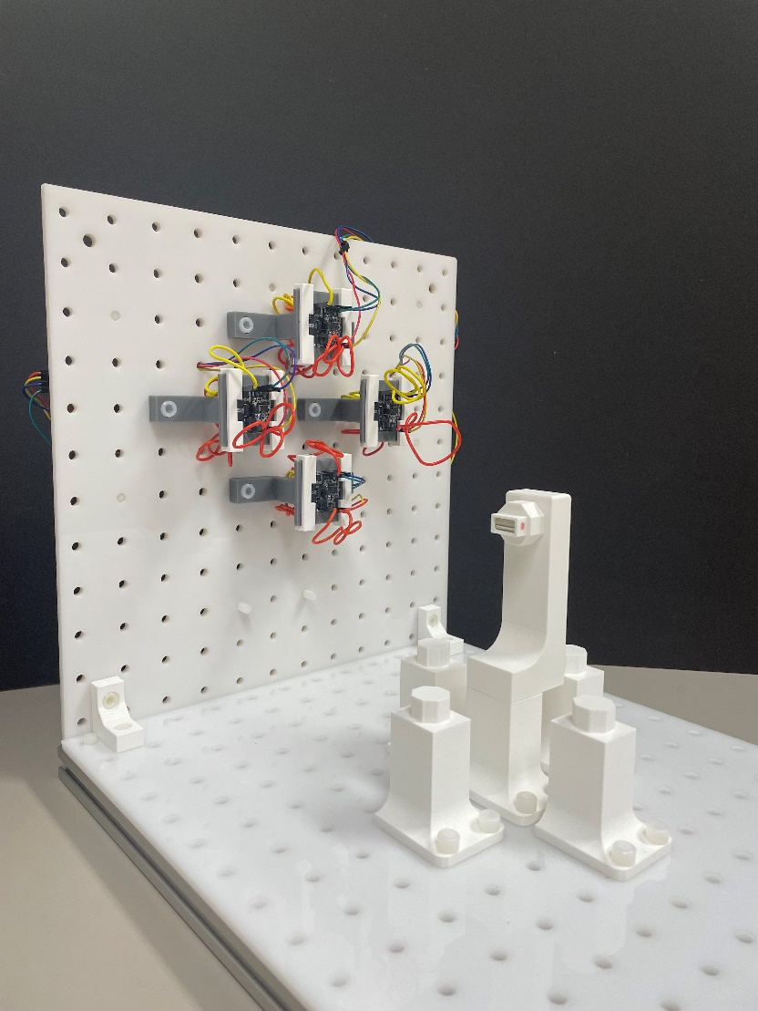
Optimizing Planar Arrays of Magnetic Sensors for Medical Robot Localization
Xiaowei Lin
Supervisors:
Prof. Dr. Pierre E. Dupont Prof. Dr. Giovanni Pittiglio
Prof. Dr. Bradley J. Nelson
Master’s Thesis Presentation
October 11th , 2024

Slide 2
Index
Motivation
Problem definition
Proposed approach
Magnetic field model
Gauss-Newton on manifold algorithm
Optimization of the sensor configuration
Experiments
Conclusion and outlooks

Slide 3
Index
Motivation
Problem definition
Proposed approach
Magnetic field model
Gauss-Newton on manifold algorithm
Optimization of the sensor configuration
Experiments
Conclusion and outlooks

Slide 4
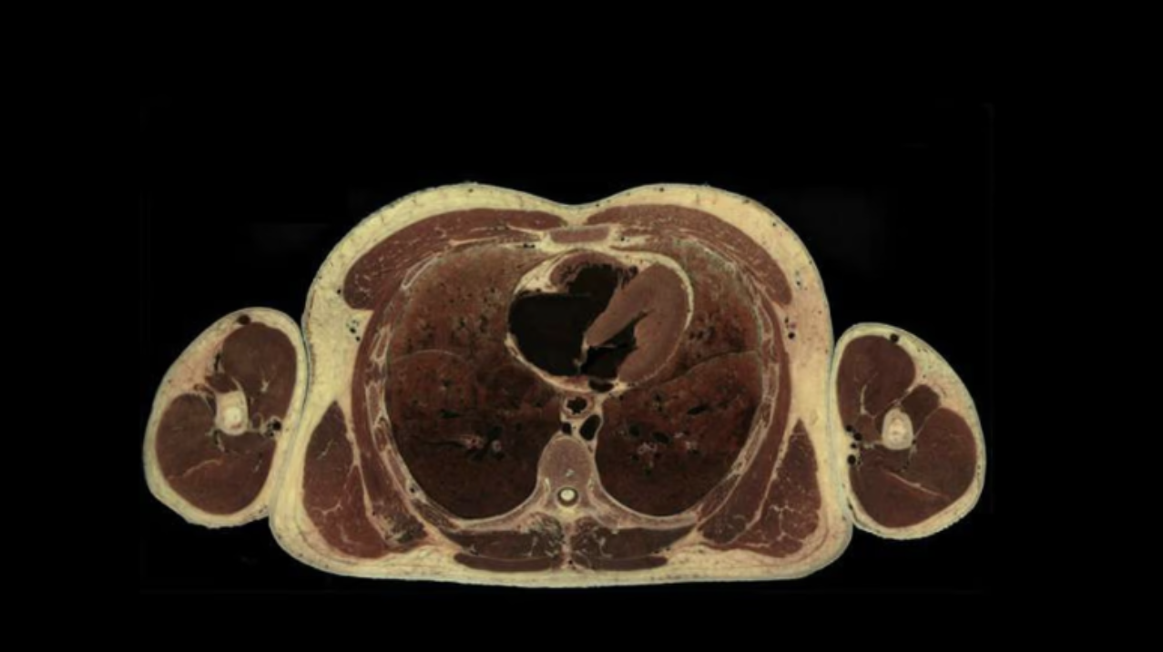

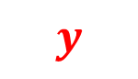
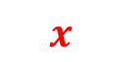
Motivation
$$z$$
$$y$$
$$x$$
Notes:
Imagine a patient lying on the operating bed and this is the coronal plane of the patient. A robotic catheter is operating in the patient’s heart. To achieve good control, it is beneficial to have an idea of the shape of the catheter. This can be done by inserting a fiber optic into the catheter and use the light deflection to sense the shape. But this method is very costly. Another approach can be mounting a magnet at the top of the catheter, which is tracked by a system of magnetic sensors. By localization the magnet, we can back calculate the shape of the catheter using some modeling technique, such as a constant curvature model. So, we are interested in tracking the magnet’s configuration using an array of the magnetic sensors mounted on the operating bed. Let’s look at it from a different angle. This is the setup we are interested in, where a magnet is operating in the spherical workspace that resembles the heart. The magnet has a local frame attached to it, representing its configuration, position and orientation. The z-axis of the local frame is assumed to be aligned with the magnet’s dipole direction, pointing from the south to north pole. It’s a 5DOF system because the rotation around the z-axis of a magnetic dipole does not change the magnetic field. The spherical workspace has 10cm diameter, which is similar to the size of human heart. The bottom of the sphere is 10cm away from the operating bed, where the sensors are placed. The sensors’ orientations are assumed to be aligned with the world frame. Different configuration of the magnet will generate different magnetic field, which can be captured by the sensors. We are interested in solving the magnet configuration based on the magnetic field measured by the sensors.

Slide 5
Index
Motivation
Problem definition
Proposed approach
Magnetic field model
Gauss-Newton on manifold algorithm
Optimization of the sensor configuration
Experiments
Conclusion and outlooks

Slide 6
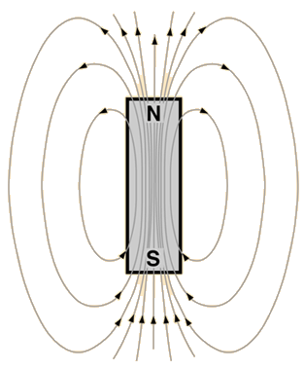
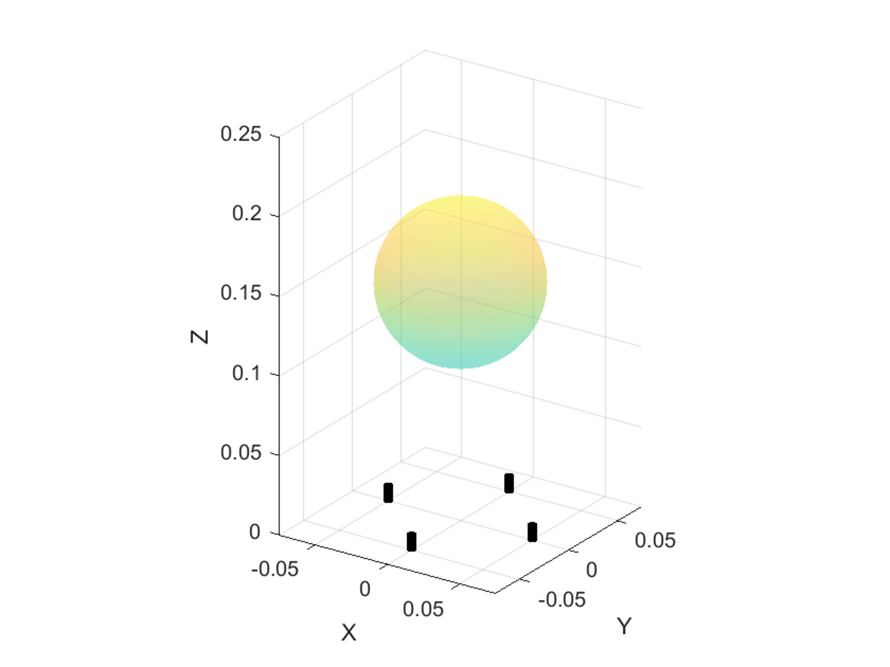
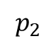
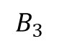
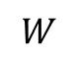
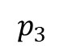
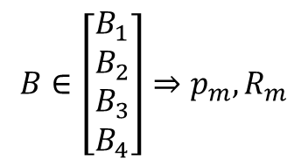
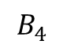

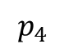
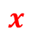
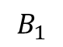
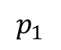

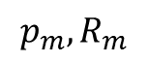
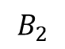
Problem definition
$$p_{m}, R_{m}$$
$$B_{2}$$
$$B_{3}$$
$$z$$
$$p_{2}$$
$$B_{1}$$
$$y$$
$$W$$
$$p_{3}$$
$$B_{4}$$
$$p_{1}$$
$$x$$
$$p_{4}$$
$$B∈\left[\begin{matrix}B_{1} \\ B_{2} \\ \begin{matrix}B_{3} \\ B_{4}\end{matrix}\end{matrix}\right]⇒p_{m},R_{m}$$
Notes:
Let’s define the problem in detail. This is the setup we are interested in. We model the heart as the spherical workspace whose diameter is 10cm and the bottom is 10cm away from the sensor array. It resembles the dimension of a human body. The magnet is modeled as a magnetic dipole, generating the magnetic field. The magnet has a local frame attached to it, representing its configuration, position and orientation. The z-axis of the local frame is aligned with the magnet’s dipole direction, pointing from the south to north pole. The magnetic field is captured by a number of sensors placed on the operating bed, whose coordinate frames are aligned with the world frame. It simplifies the problem because we can express everything with respect to the world frame. Different configuration of the magnet will generate different magnetic field. We are interested in solving the magnet configuration based on the magnetic field measured by the sensors.

Slide 7
Index
Motivation
Problem definition
Proposed approach
Magnetic field model
Gauss-Newton on manifold algorithm
Optimization of the sensor configuration
Experiments
Conclusion and outlooks

Slide 8
Index
Motivation
Problem definition
Proposed approach
Magnetic field model
Gauss-Newton on manifold algorithm
Optimization of the sensor configuration
Experiments
Conclusion and outlooks

Slide 9
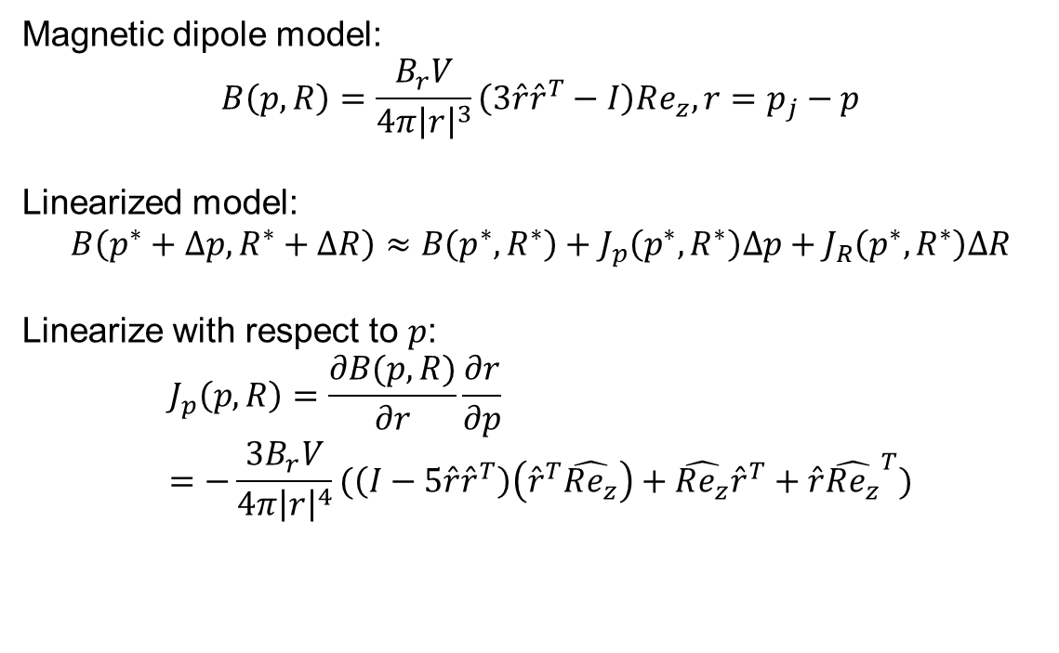
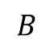
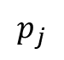
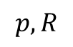
Magnetic dipole model and its linearization
Magnetic dipole model:
$$B\left(p, R\right)=\frac{B_{r}V}{4π{\left|r\right|}^{3}}\left(3\hat{r}{\hat{r}}^{T}−I\right)Re_{z}, r=p_{j}−p$$
Linearized model:
$$B\left(p^{∗}+Δp, R^{∗}+ΔR\right)≈B\left(p^{∗},R^{∗}\right)+J_{p}\left(p^{∗},R^{∗}\right)Δp+J_{R}\left(p^{∗},R^{∗}\right)ΔR$$
Linearize with respect to $p$:
$$J_{p}\left(p,R\right)=\frac{∂B(p,R)}{∂r}\frac{∂r}{∂p}=−\frac{3B_{r}V}{4π{\left|r\right|}^{4}}(\left(I−5\hat{r}{\hat{r}}^{T}\right)\left({\hat{r}}^{T}\hat{Re_{z}}\right)+\hat{Re_{z}}{\hat{r}}^{T}+\hat{r}{\hat{Re_{z}}}^{T})$$
$$p, R$$
$$B$$
$$p_{j}$$
Notes:
The magnetic field generated by a magnet with certain configuration at a position p_j is given by the dipole model, which is highly nonlinear and difficult to analyze.

Slide 10
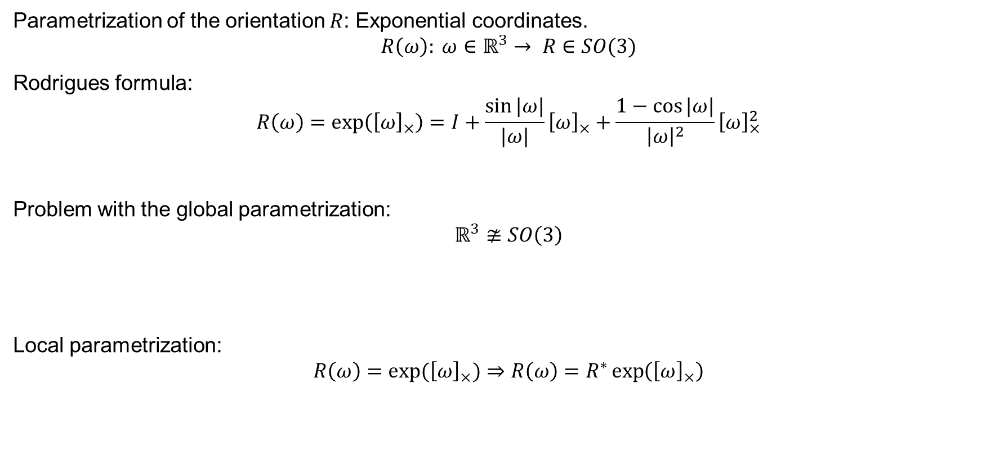

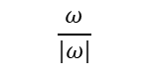
Linearize with respect to orientation
Parametrization of the orientation $R$: Exponential coordinates.
$$R\left(ω\right): ω∈ℝ^{3}→ R∈SO(3)$$
Rodrigues formula:
$$R\left(ω\right)=\exp\left({\left[ω\right]}_{×}\right)=I+\frac{\sin{|ω|}}{|ω|}{\left[ω\right]}_{×}+\frac{1−\cos{|ω|}}{{\left|ω\right|}^{2}}{\left[ω\right]}_{×}^{2}$$
Problem with the global parametrization:
$$ℝ^{3}≇SO\left(3\right)$$
Local parametrization:
$$R\left(ω\right)=\exp{({\left[ω\right]}_{×})}⇒R\left(ω\right)=R^{∗}\exp\left({\left[ω\right]}_{×}\right)$$
$$\frac{ω}{|ω|}$$
$$|ω|$$
Notes:
The linearization assumed the parameter are lying in the Euclidean space. To compute the linearization with respect to orientation, which lies in the Lie group of SO(3), we need to find some parametrization of the rotation that lies in the Euclidean space, such as the Euler angles or the exponential coordinates. The exponential coordinate is a vector in R3, which can be mapped to the space of SO(3) using the Rodrigues formula. It’s a global parametrization, mean the origin of exponential coordinate corresponds to the Identity in SO(3). However, because the Euclidean space R3 is not isomorphic to SO(3), all of these global parametrization, including Euler angles and exponential coordinates suffer from singularity or other anomalies in various points in the parameter space. An example is that when you calculate the Jacobian of the magnetic field with respect to the exponential coordinate, the null-space of that matrix does not correspond to a z-axis rotation. It means that z-axis rotation change the magnetic field, which is not physically correct. It prevents us from analyzing the behavior using the linear model and it will cause serious problem in solving for the magnet’s configuration, which will be introduced in later sections.
To solve this problem, a local parametrization is used. Namely, at the interested rotation R_star, move the origin of the exponential coordinate to R_star by pre-multiply to the exponential coordinate mapping. Now the origin omega=0 corresponds to orientation=R*. This is why it’s called a local parametrization. To compute the Jacobian at a certain rotation R_star, we simply rewrite the rotation matrix and take the partial derivative with respect to omega and evaluate it at 0. This local parametrization solves the null-space issue, allowing us to use the linearized model to analyze the local behavior of the magnetic dipole model.

Slide 11
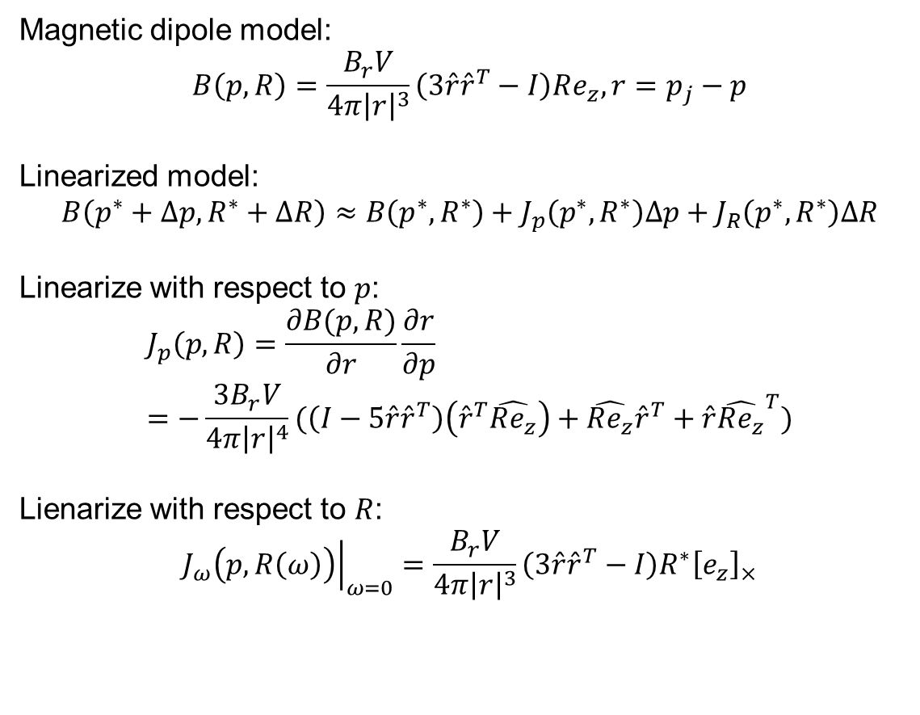
Magnetic dipole model and its linearization
Magnetic dipole model:
$$B\left(p, R\right)=\frac{B_{r}V}{4π{\left|r\right|}^{3}}\left(3\hat{r}{\hat{r}}^{T}−I\right)Re_{z}, r=p_{j}−p$$
Linearized model:
$$B\left(p^{∗}+Δp, R^{∗}+ΔR\right)≈B\left(p^{∗},R^{∗}\right)+J_{p}\left(p^{∗},R^{∗}\right)Δp+J_{R}\left(p^{∗},R^{∗}\right)ΔR$$
Linearize with respect to $p$:
$$J_{p}\left(p,R\right)=\frac{∂B(p,R)}{∂r}\frac{∂r}{∂p}=−\frac{3B_{r}V}{4π{\left|r\right|}^{4}}(\left(I−5\hat{r}{\hat{r}}^{T}\right)\left({\hat{r}}^{T}\hat{Re_{z}}\right)+\hat{Re_{z}}{\hat{r}}^{T}+\hat{r}{\hat{Re_{z}}}^{T})$$
Lienarize with respect to $R$:
$${\left.J_{ω}\left(p,R\left(ω\right)\right)\right|}_{ω=0}=\frac{B_{r}V}{4π{\left|r\right|}^{3}}\left(3\hat{r}{\hat{r}}^{T}−I\right)R^{∗}{\left[e_{z}\right]}_{×}$$
$$p, R$$
$$B$$
$$p_{j}$$
Notes:
The magnetic field generated by a magnet with certain configuration at a position p_j is given by the dipole model, which is highly nonlinear and difficult to analyze.

Slide 12
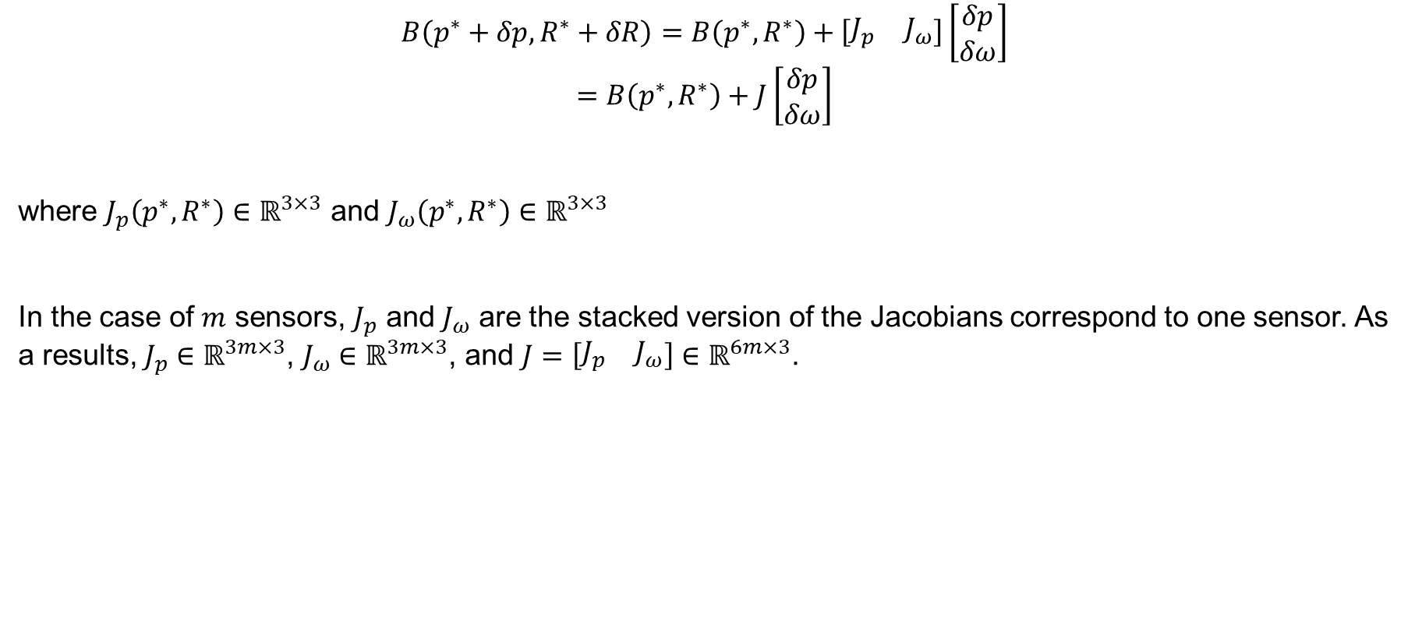
Linearized magnetic dipole model - Summary
$$B\left(p^{∗}+δp,R^{∗}+δR\right)=B\left(p^{∗},R^{∗}\right)+\left[\begin{matrix}J_{p} & J_{ω}\end{matrix}\right]\left[\begin{matrix}δp \\ δω\end{matrix}\right]$$
$$=B\left(p^{∗},R^{∗}\right)+J\left[\begin{matrix}δp \\ δω\end{matrix}\right]$$
where $J_{p}\left(p^{∗},R^{∗}\right)∈ℝ^{3×3}$ and $J_{ω}\left(p^{∗},R^{∗}\right)∈ℝ^{3×3}$
In the case of $m$ sensors, $J_{p}$ and $J_{ω}$ are the stacked version of the Jacobians correspond to one sensor. As a results, $J_{p}∈ℝ^{3m×3}$, $J_{ω}∈ℝ^{3m×3}$, and $J=\left[\begin{matrix}J_{p} & J_{ω}\end{matrix}\right]∈ℝ^{6m×3}$.
Notes:
To summarize, we derive the linearized magnetic field model for one magnetic sensor. In the case of multiple sensors, we can simply stack the Jacobian for individual sensor and get the full expression.

Slide 13
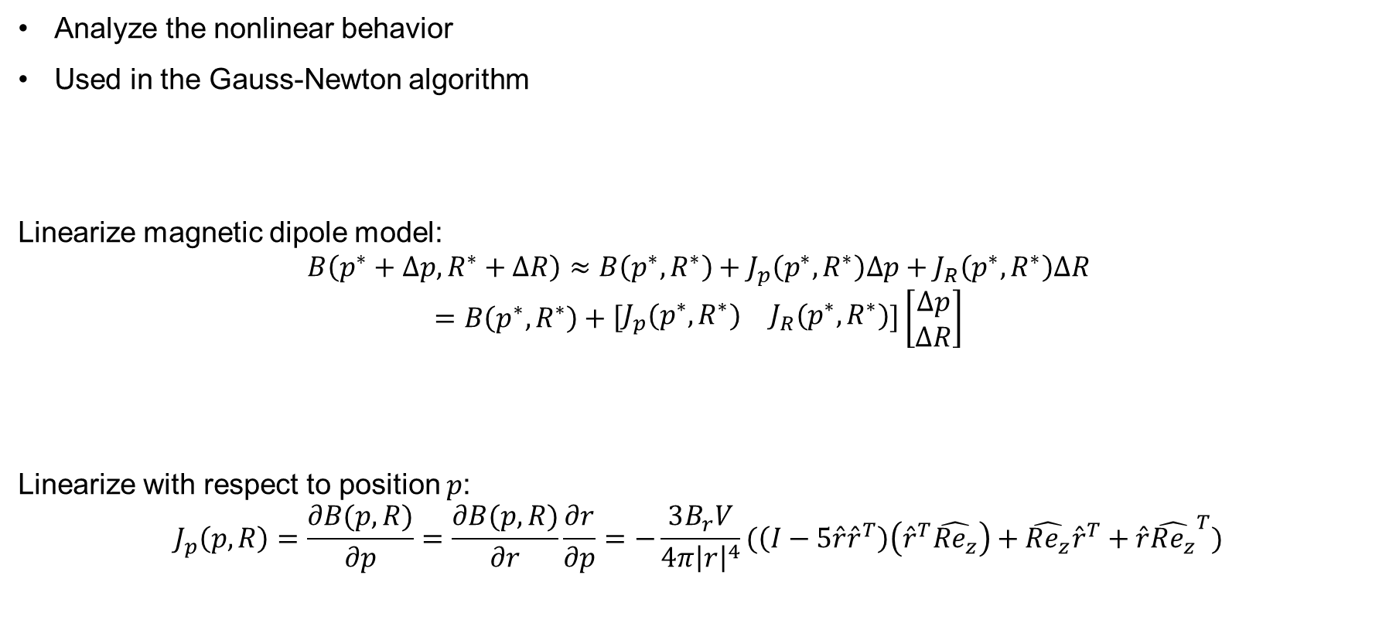
Linearized magnetic dipole model
Analyze the nonlinear behavior
Used in the Gauss-Newton algorithm
Linearize magnetic dipole model:
$$B\left(p^{∗}+Δp, R^{∗}+ΔR\right)≈B\left(p^{∗},R^{∗}\right)+J_{p}\left(p^{∗},R^{∗}\right)Δp+J_{R}\left(p^{∗},R^{∗}\right)ΔR$$
$$=B\left(p^{∗},R^{∗}\right)+\left[\begin{matrix}J_{p}(p^{∗},R^{∗}) & J_{R}(p^{∗},R^{∗})\end{matrix}\right]\left[\begin{matrix}Δp \\ ΔR\end{matrix}\right]$$
Linearize with respect to position $p$:
$$J_{p}\left(p,R\right)=\frac{∂B(p,R)}{∂p}=\frac{∂B(p,R)}{∂r}\frac{∂r}{∂p}=−\frac{3B_{r}V}{4π{\left|r\right|}^{4}}(\left(I−5\hat{r}{\hat{r}}^{T}\right)\left({\hat{r}}^{T}\hat{Re_{z}}\right)+\hat{Re_{z}}{\hat{r}}^{T}+\hat{r}{\hat{Re_{z}}}^{T})$$
Notes:
We are interested in the linearized model. It allows us to analyze the nonlinear behavior and it’s used in the Gauss-Newton algorithm that solve the magnet’s configuration. The linearized model is a local model. It requires us to linearize the model at a certain point, in our case, a certain magnet configuration p_star, R_star. It allows us to estimate how the magnetic field change when the configuration deviate from p_star, R_star. Taylor series is applied to obtain the linear model, where J_p and J_R are the Jacobian of the nonlinear function with respect to the parameter of position and orientation. The Jacobian with respect to position can be obtained using the chain rule.

Slide 14
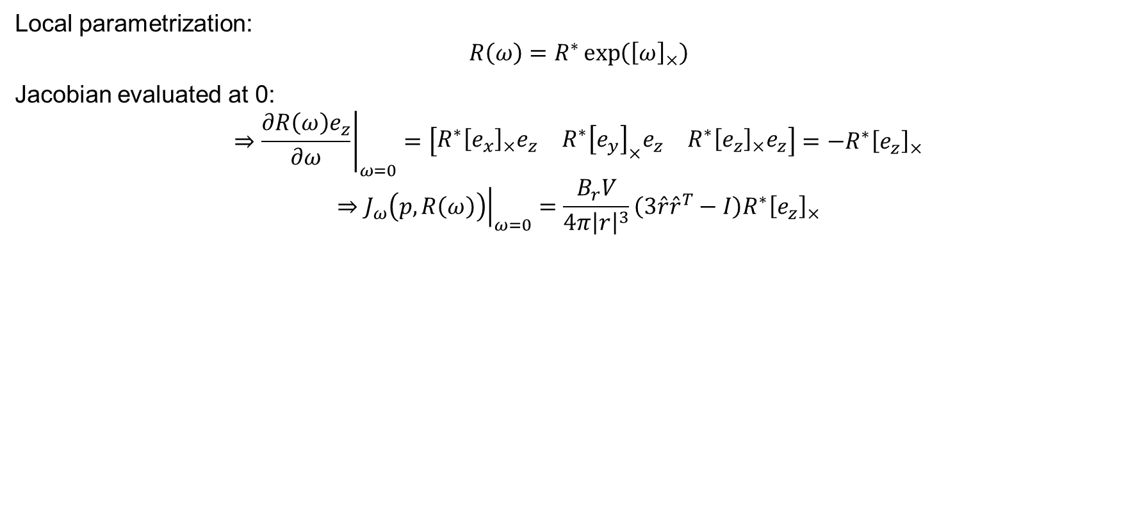
Linearize with respect to orientation
Local parametrization:
$$R\left(ω\right)=R^{∗}\exp\left({\left[ω\right]}_{×}\right)$$
Jacobian evaluated at 0:
$$⇒{\left.\frac{∂R\left(ω\right)e_{z}}{∂ω}\right|}_{ω=0}=\left[\begin{matrix}R^{∗}{\left[e_{x}\right]}_{×}e_{z} & R^{∗}{\left[e_{y}\right]}_{×}e_{z} & R^{∗}{\left[e_{z}\right]}_{×}e_{z}\end{matrix}\right]=−R^{∗}{\left[e_{z}\right]}_{×}$$
$$⇒{\left.J_{ω}\left(p,R\left(ω\right)\right)\right|}_{ω=0}=\frac{B_{r}V}{4π{\left|r\right|}^{3}}\left(3\hat{r}{\hat{r}}^{T}−I\right)R^{∗}{\left[e_{z}\right]}_{×}$$

Slide 15
Index
Motivation
Problem definition
Magnetic field model
Gauss-Newton on manifold algorithm
Optimization of the sensor configuration
Experiments\
Conclusion and outlooks
Notes:
As we mentioned before, one of the reasons we need the linearized model is that it is used in the Gauss-Newton algorithm that solves for the magnet’s configuration based on the magnetic field captured by the sensor.

Slide 16
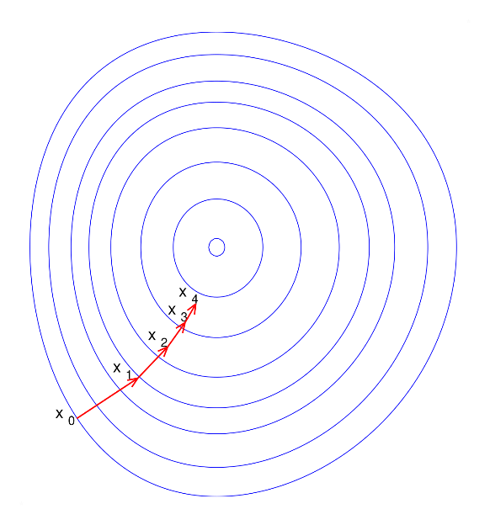
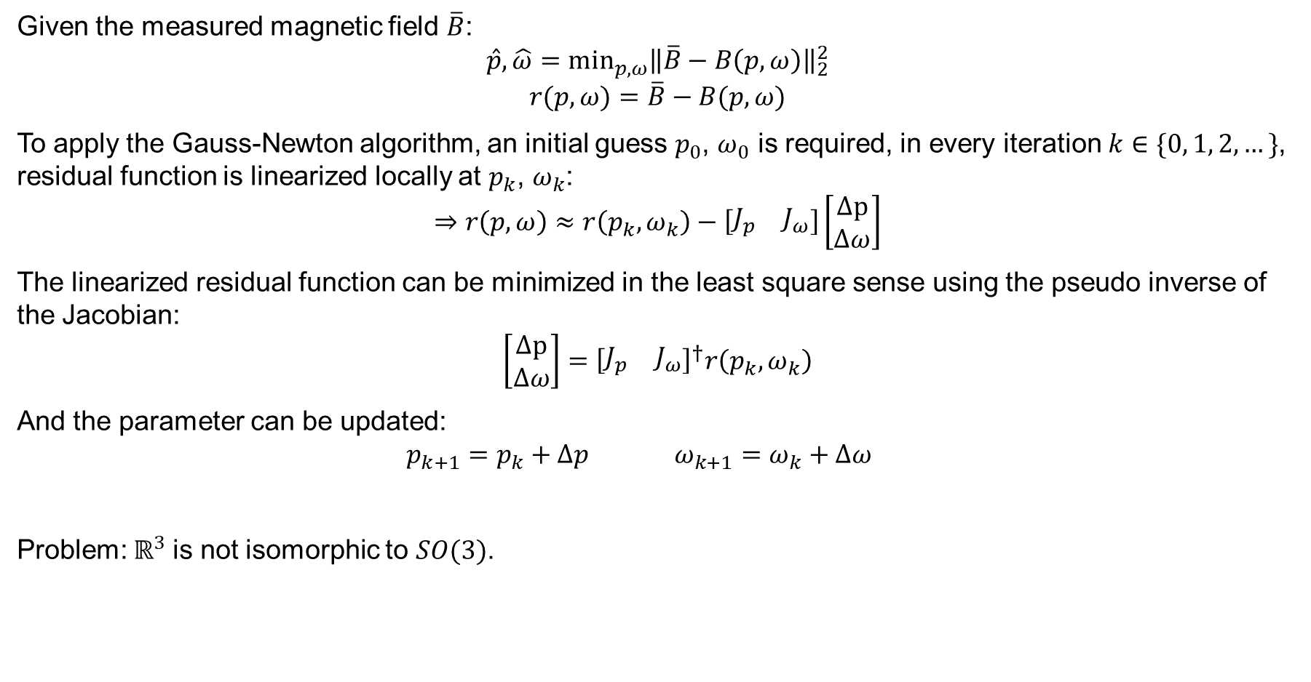
Classic Gauss-Newton algorithm
Given the measured magnetic field $\overline{B}$:
$$\hat{p}, \hat{ω}=\min_{p, ω}{\left\|\overline{B}−B\left(p,ω\right)\right\|}_{2}^{2}$$
$$r(p,ω)=\overline{B}−B(p,ω)$$
To apply the Gauss-Newton algorithm, an initial guess $p_{0}$, $ω_{0}$ is required, in every iteration $k∈\{0, 1, 2,…\}$, residual function is linearized locally at $p_{k}$, $ω_{k}$:
$$⇒r\left(p,ω\right)≈r\left(p_{k},ω_{k}\right)−\left[\begin{matrix}J_{p} & J_{ω}\end{matrix}\right]\left[\begin{matrix}Δp \\ Δω\end{matrix}\right]$$
The linearized residual function can be minimized in the least square sense using the pseudo inverse of the Jacobian:
$$\left[\begin{matrix}Δp \\ Δω\end{matrix}\right]={\left[\begin{matrix}J_{p} & J_{ω}\end{matrix}\right]}^{†}r\left(p_{k},ω_{k}\right)$$
And the parameter can be updated:
$$p_{k+1}=p_{k}+Δp ω_{k+1}=ω_{k}+Δω$$
Problem: $ℝ^{3}$is not isomorphic to $SO(3)$.
Notes:
Given the measured magnetic field $\overline{B}$, we can find the magnet’s configuration that the residual between the estimated magnetic field and the measurement is minimized. Gauss-Newton method can be used to solve this minimization problem. To apply the Gauss-Newton method, we start with an initial guess p_0, w_0 and update the guess iteratively. In every iteration, the residual function is linearized at the current guess. As you can see, B_bar is just a constant vector. So the linearized residual function is nothing more than the negative of the linearized magnetic field model. This linearized problem can be solved by taking the pseudo inverse of the Jacobian and the update step is taken in the Euclidean space using simple summation.
The classic Gauss-Newton algorithm assumes the unknown parameter on some vector space isomorphic to the Euclidean space. It works naturally with the position because it exactly lies in the space of R3. For orientation, which lies in SO(3), we parametrize it in the Euclidean space, using the exponential coordinates. However, as mentioned before, SO(3) is not isomorphic to R3, which will cause serious problem when applying these algorithms. Because the descent direction in R3 is not necessarily the descent direction in SO(3).

Slide 17
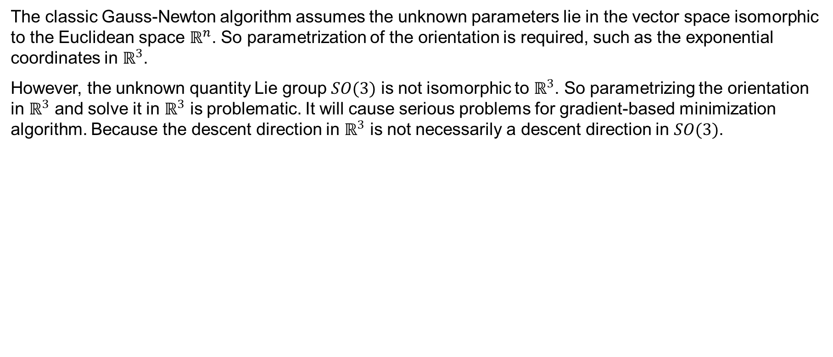
Problem with the classic Gauss-Newton algorithm
The classic Gauss-Newton algorithm assumes the unknown parameters lie in the vector space isomorphic to the Euclidean space $ℝ^{n}$. So parametrization of the orientation is required, such as the exponential coordinates in $ℝ^{3}$.
However, the unknown quantity Lie group $SO(3)$ is not isomorphic to $ℝ^{3}$. So parametrizing the orientation in $ℝ^{3}$ and solve it in $ℝ^{3}$ is problematic. It will cause serious problems for gradient-based minimization algorithm. Because the descent direction in $ℝ^{3}$ is not necessarily a descent direction in $SO(3)$.
Notes:
The classic Gauss-Newton algorithm assumes the parameter to be estimated lies on some vector space isomorphic to the Euclidean space. It works natural with the position because position parametrization exactly lies in the space of R3. For orientation, which lies in SO(3), we parametrize it in the Euclidean space, using the exponential coordinates. However, as mentioned before, SO(3) is not isomorphic to R3, which will cause serious problem when applying these algorithms. Because the descent direction in R3 is not necessarily the descent direction in SO(3).

Slide 18
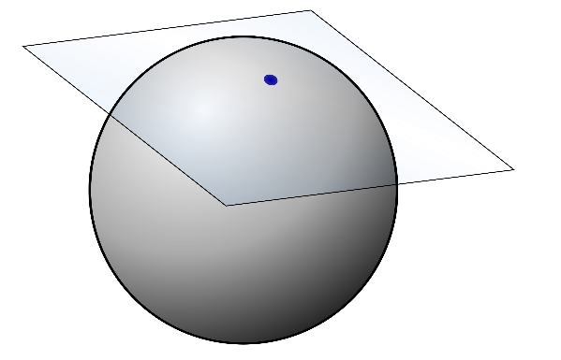
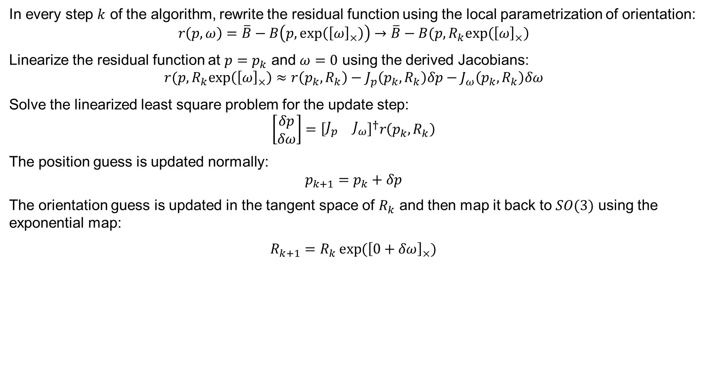
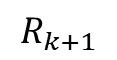
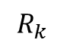
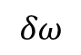
Gauss-Newton on manifold algorithm
In every step $k$ of the algorithm, rewrite the residual function using the local parametrization of orientation:
$$r\left(p,ω\right)=\overline{B}−B\left(p,exp\left({\left[ω\right]}_{×}\right)\right)→\overline{B}−B(p,R_{k}exp\left({\left[ω\right]}_{×}\right)$$
Linearize the residual function at $p=p_{k}$ and $ω=0$ using the derived Jacobians:
$$r(p,R_{k}exp\left({\left[ω\right]}_{×}\right)≈r\left(p_{k},R_{k}\right)−J_{p}\left(p_{k},R_{k}\right)δp−J_{ω}\left(p_{k},R_{k}\right)δω$$
Solve the linearized least square problem for the update step:
$$\left[\begin{matrix}δp \\ δω\end{matrix}\right]={\left[\begin{matrix}J_{p} & J_{ω}\end{matrix}\right]}^{†}r\left(p_{k},R_{k}\right)$$
The position guess is updated normally:
$$p_{k+1}=p_{k}+δp$$
The orientation guess is updated in the tangent space of $R_{k}$ and then map it back to $SO(3)$ using the exponential map:
$R_{k+1}=R_{k}\exp{({\left[0+δω\right]}_{×})}$
$$δω$$
$$R_{k}$$
$$R_{k+1}$$
Notes:
To solve this issue, we turn to local parametrization. That is, in every step k of the algorithm, rewrite the residual function using the local parametrization of rotation. Linearize it accordingly with respect to the parameters but evaluate the Jacobian at omega=0; Then the update step is computed. The position is updated using summation, while for the orientation, it’s updated in the tangent space of R_k and mapped back to the group of SO(3) using the exponential map.

Slide 19
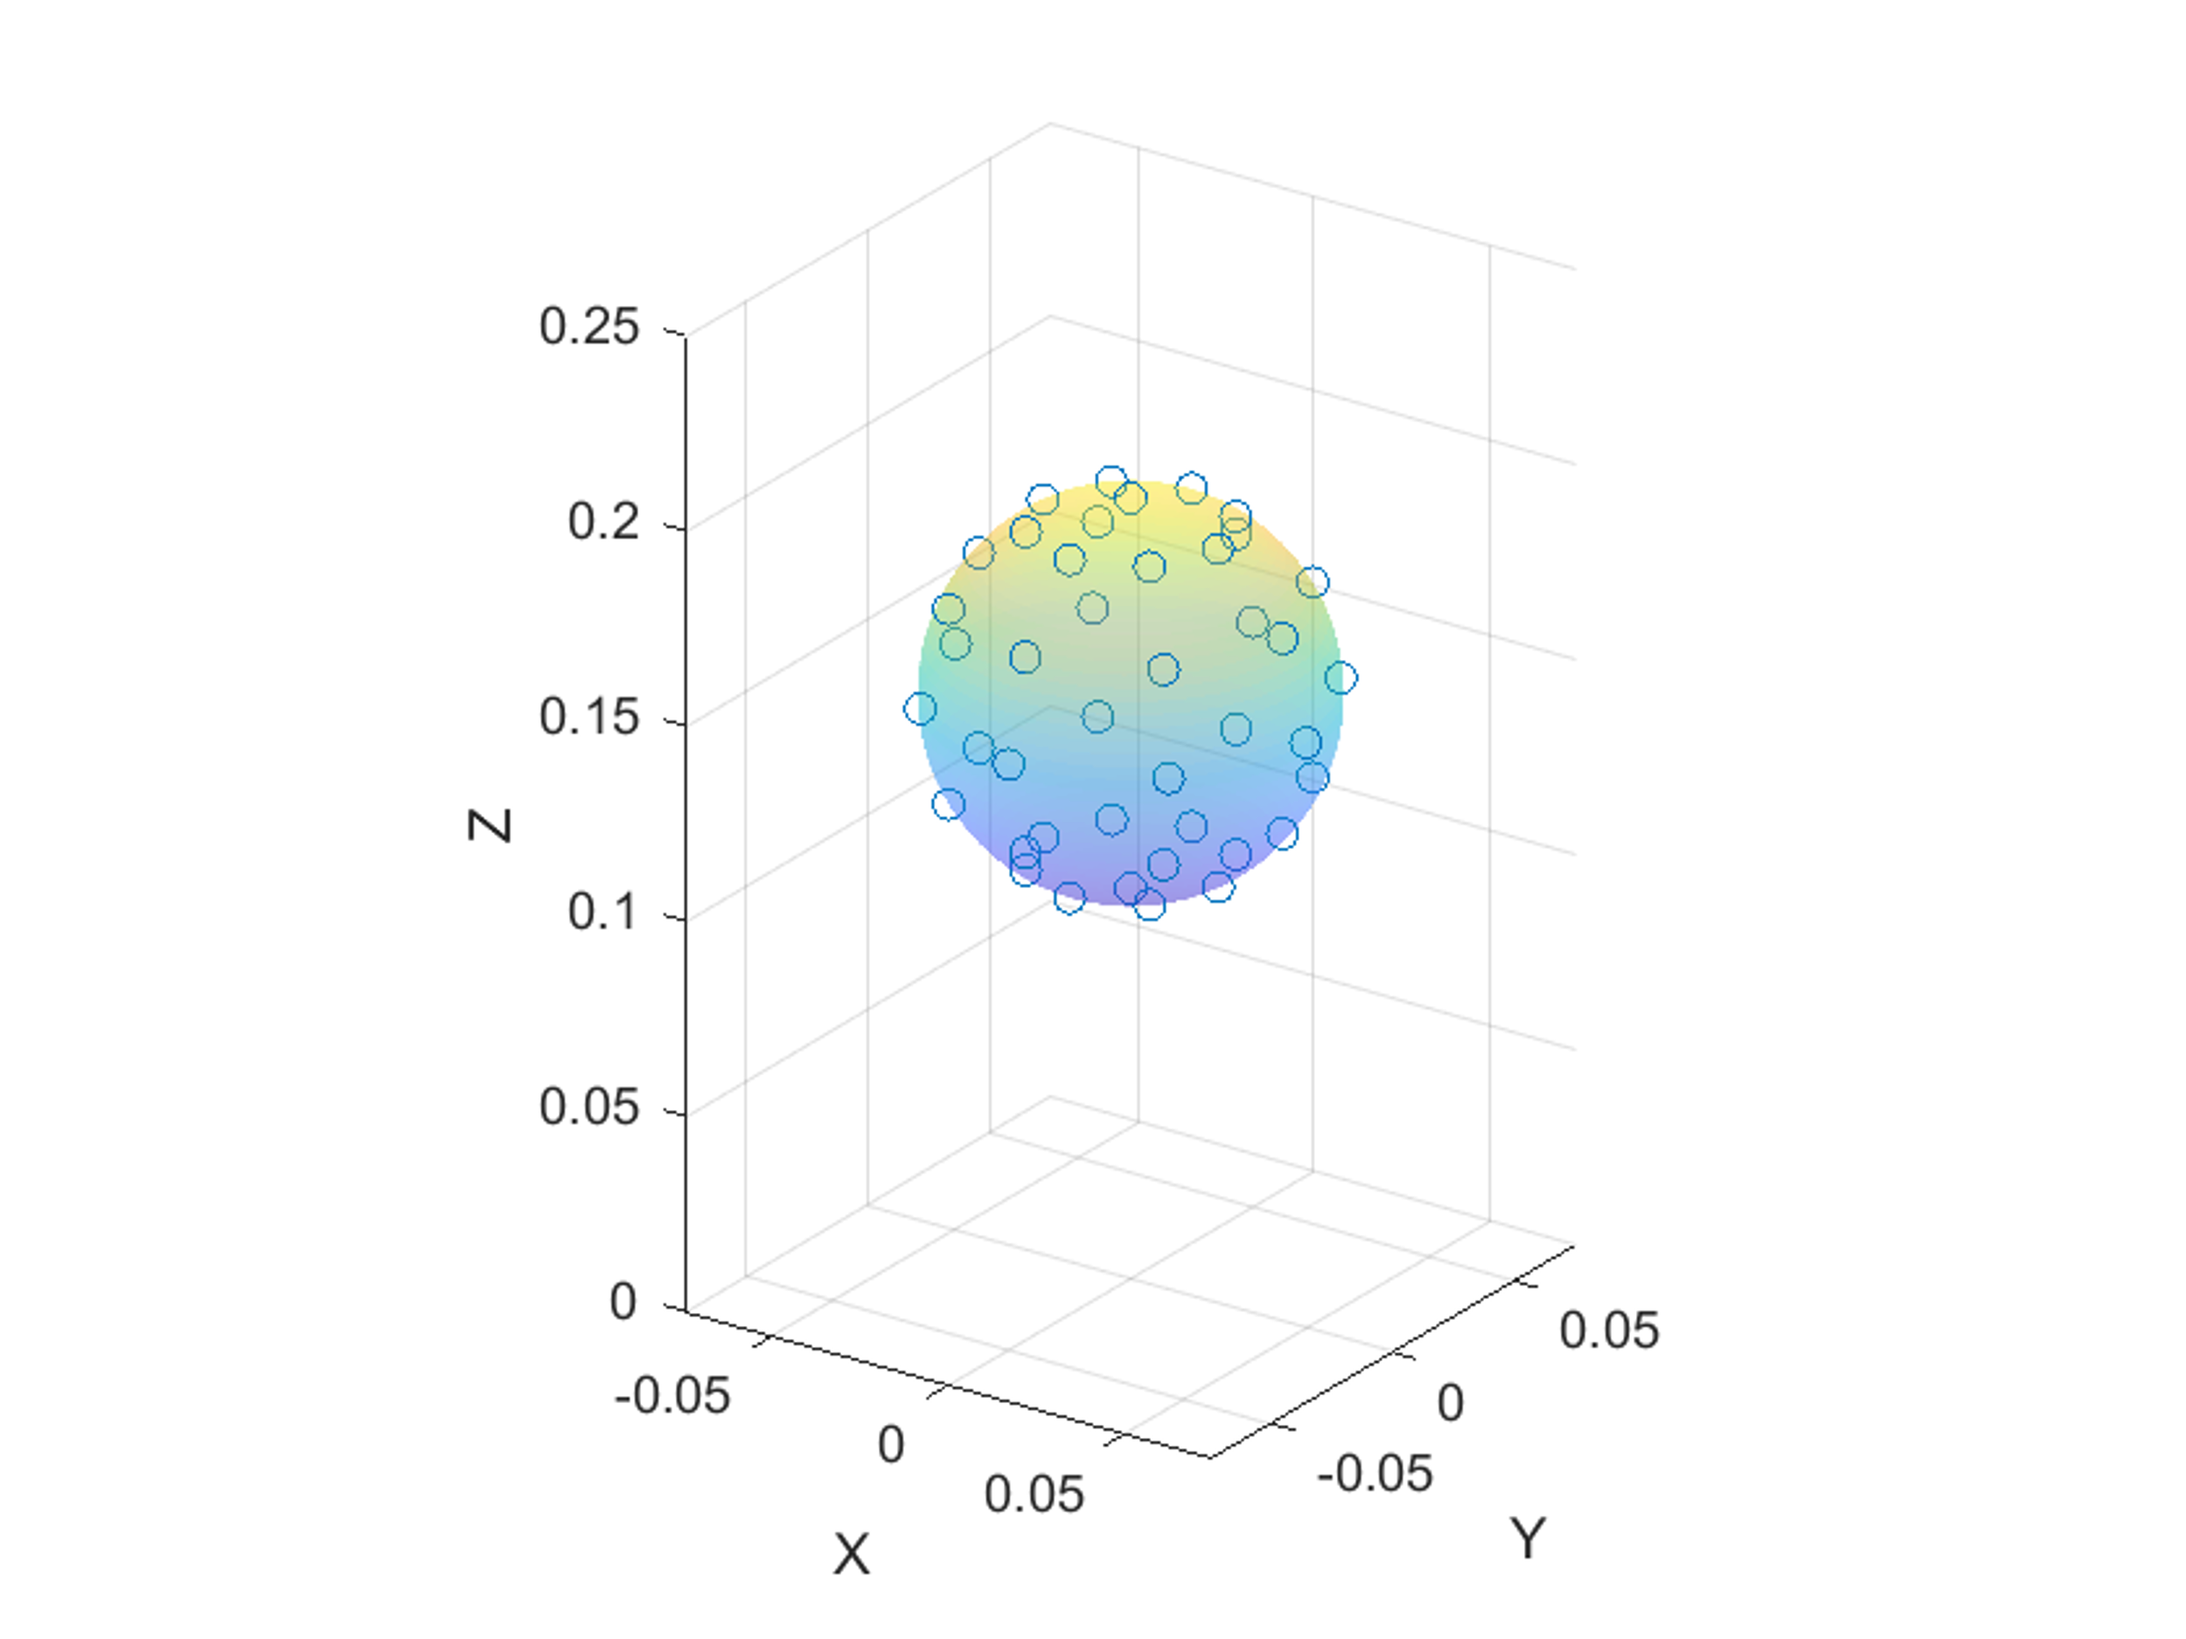
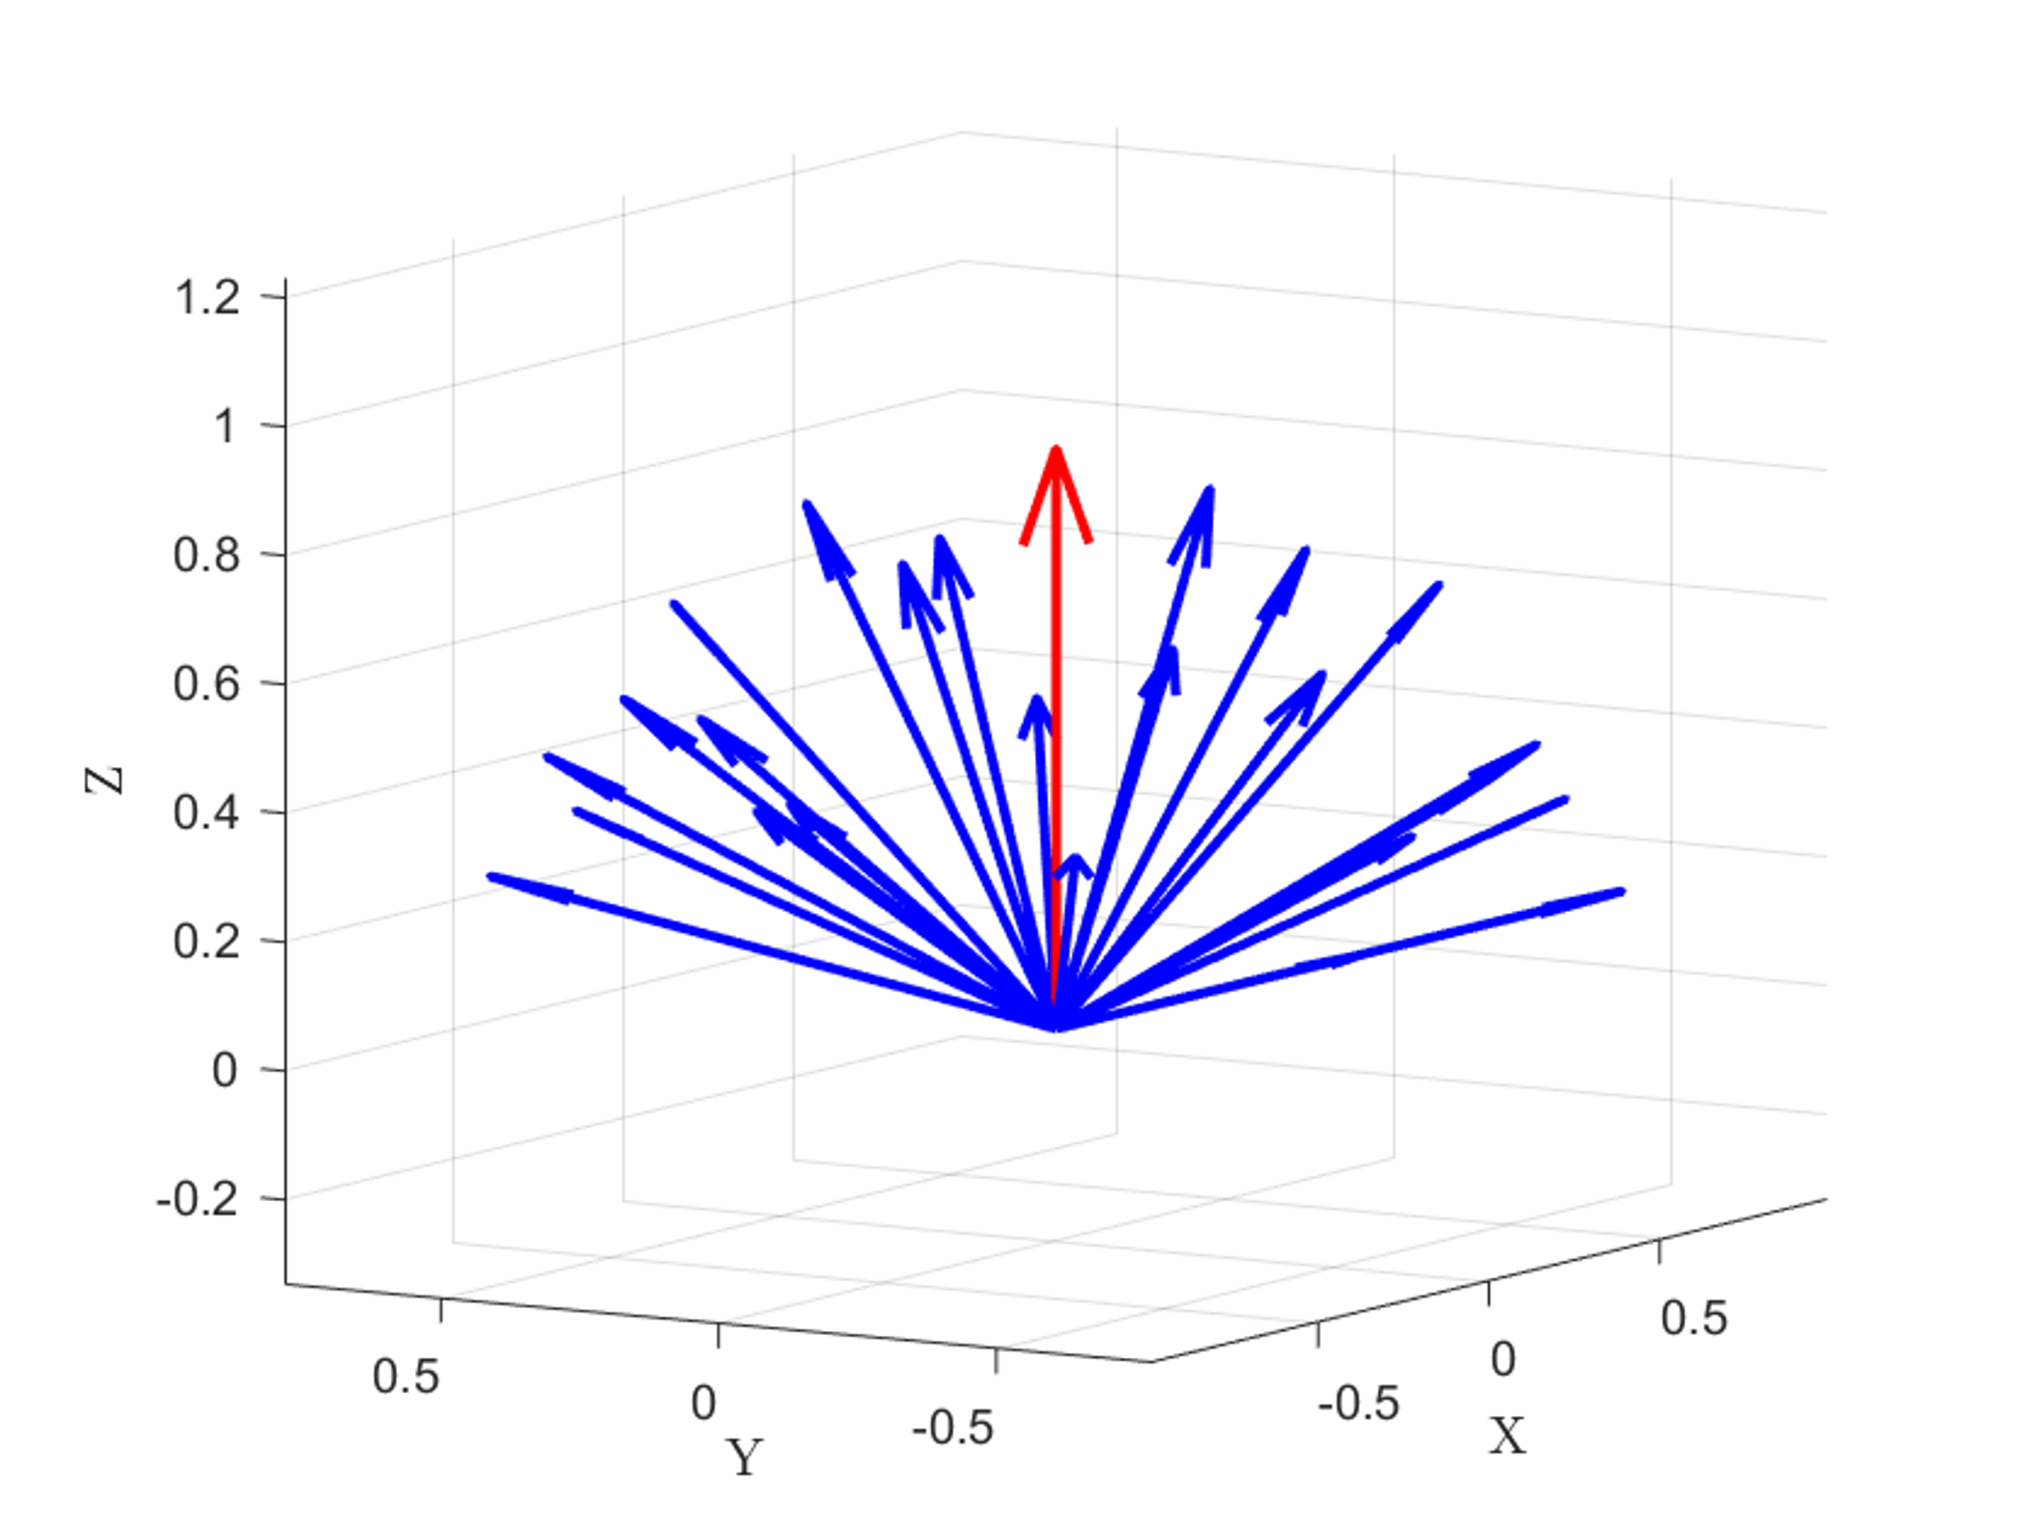
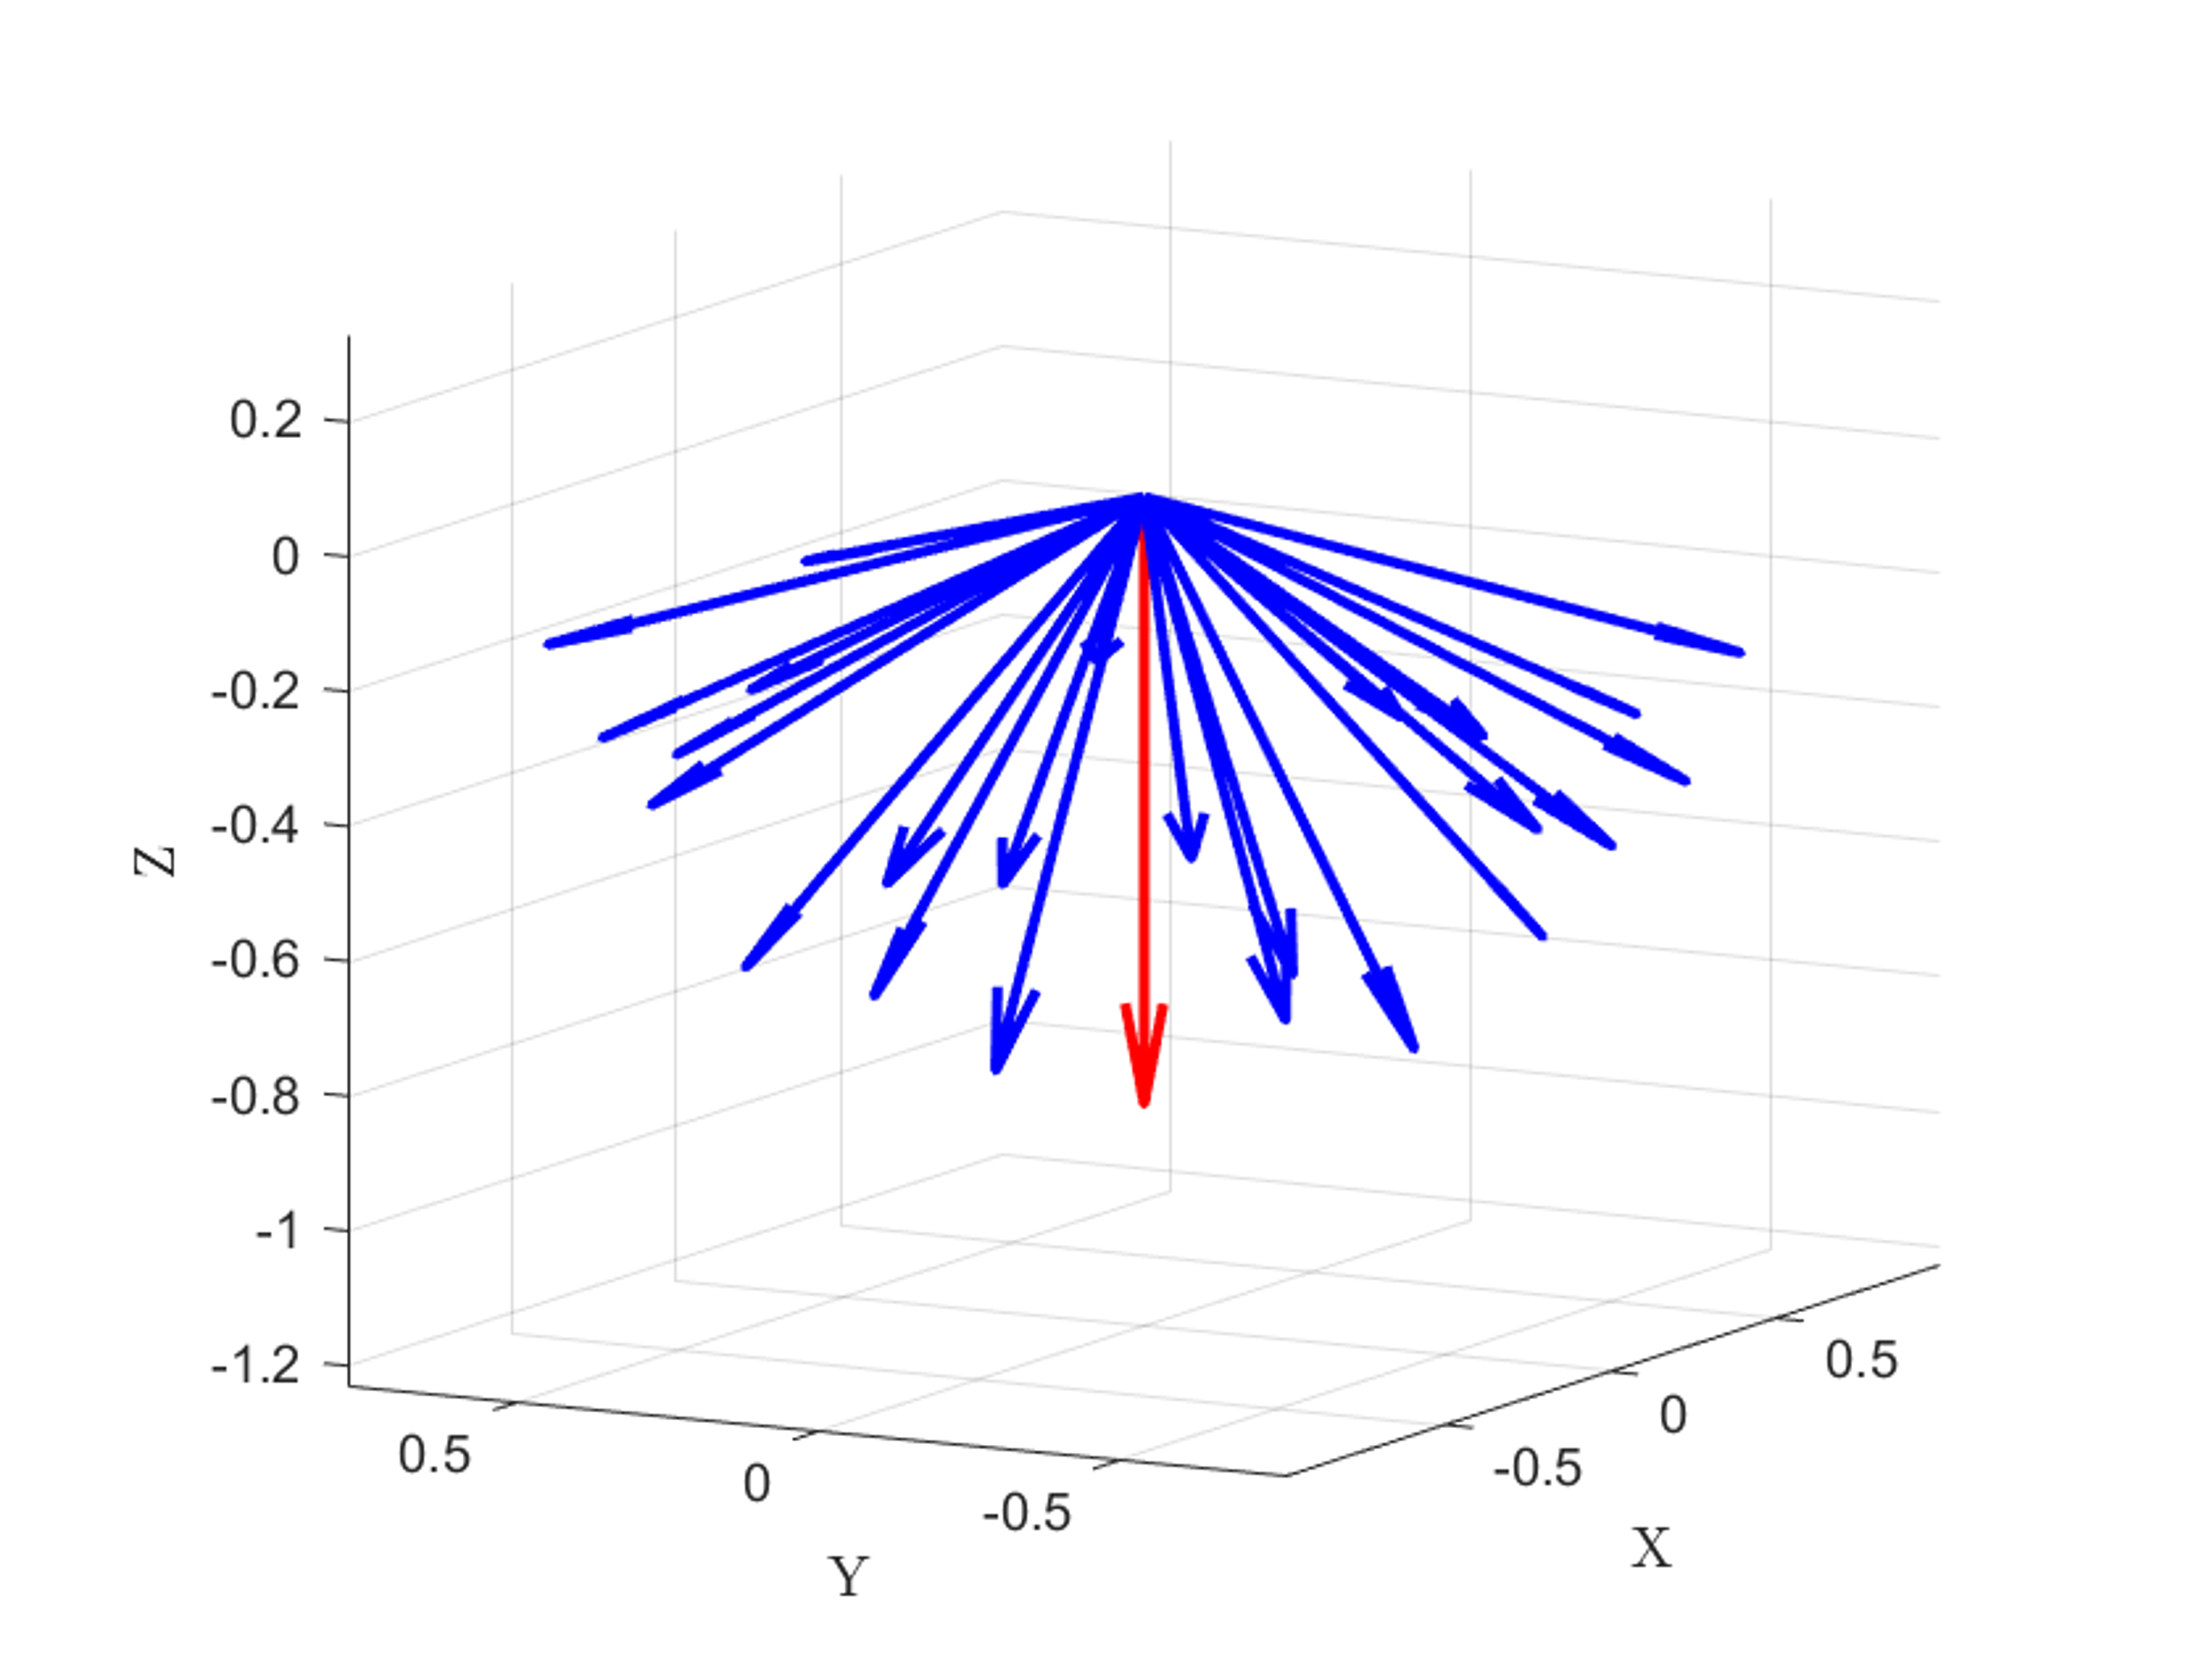
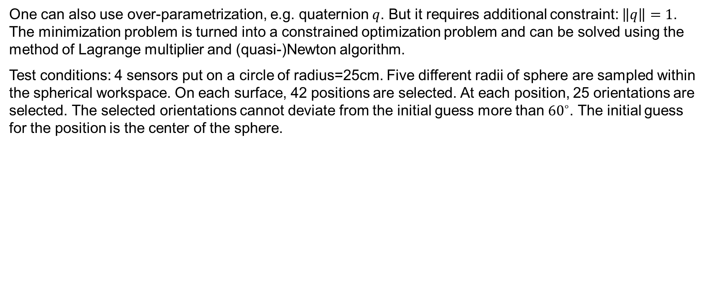
Comparison with MATLAB’s algorithm
One can also use over-parametrization, e.g. quaternion $q$. But it requires additional constraint: $\left\|q\right\|=1$. The minimization problem is turned into a constrained optimization problem and can be solved using the method of Lagrange multiplier and (quasi-)Newton algorithm.
Test conditions: 4 sensors put on a circle of radius=25cm. Five different radii of sphere are sampled within the spherical workspace. On each surface, 42 positions are selected. At each position, 25 orientations are selected. The selected orientations cannot deviate from the initial guess more than ${60}^{∘}$. The initial guess for the position is the center of the sphere.
42 positions on one sphere radius
25 orientations selected at each position
Different cone orientations
Notes:
One can also use over-parametrization to solve the singularity issue, such as the quaternion. But it requires additional constraint and it turns the minimization problem to a constrained minimization problem, which can be solved using the method of Lagrange multiplier and quasi-Newton method. This algorithm is implemented by MATLAB and we compare the Gauss-Newton algorithm to MATLAB’s algorithm in simulation.
We simulated 4 sensors on a circle of radius 25cm. And we need to sample the magnet configuration to be solved. Within the spherical workspace, 5 different radii are sampled and on each sphere, 42 positions are selected evenly. In terms of orientation, since both algorithms converge locally, we limit the orientation to be within 60 deg from the initial guess, which is like a cone of different orientations. Each cone has 25 orientations. Making it in total 5250 test configurations in one test set. To cover the entire workspace, 16 different cone orientations are considered but the initial guess for the orientation always align with the center vector of the cone. The initial guess for the position is chosen to be the center of the sphere.

Slide 20
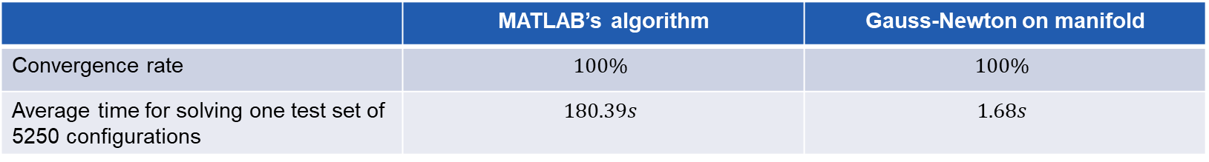
Comparison with MATLAB’s algorithm
 | MATLAB’s algorithm | Gauss-Newton on manifold
Convergence rate | $$100\%$$ | $$100\%$$
Average time for solving one test set of 5250 configurations | $$180.39s$$ | $$1.68s$$
The Gauss-Newton on manifold algorithm is ~100 times faster than the MATLAB’s algorithm.
Notes:
First we test if the algorithm converges to the solution for all the configurations. We observe that both algorithms converge 100% for all 16 test sets. In terms of the convergence speed, we witness that the Gauss-Newton algorithm is about 100 times faster than the MATLAB’s algorithm, which is advantageous for real-time application.

Slide 21
Index
Motivation
Problem definition
Magnetic field model
Gauss-Newton on manifold algorithm
Optimization of the sensor configuration
Experiments
Conclusion and outlooks
Notes:
With the algorithm developed, we aim to optimize the sensor configuration such that the algorithm works better, either with higher accuracy or faster speed.

Slide 22
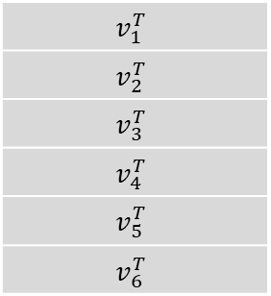
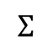
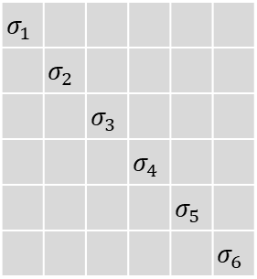
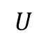
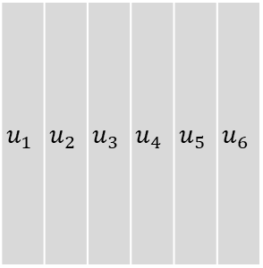
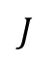
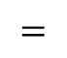

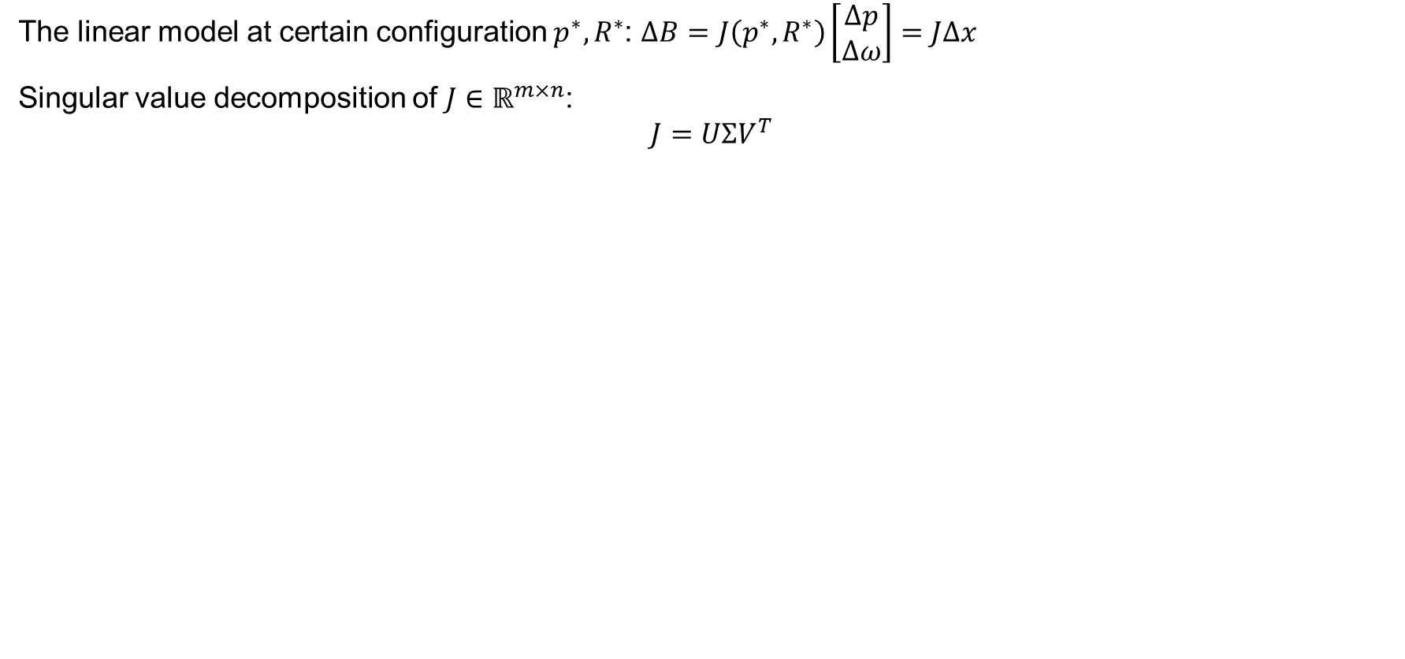

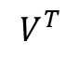
Optimization criteria - Minimum singular value $σ_{min}$
The linear model at certain configuration $p^{∗},R^{∗}$: $ΔB=J\left(p^{∗},R^{∗}\right)\left[\begin{matrix}Δp \\ Δω\end{matrix}\right]=JΔx$
Singular value decomposition of $J∈ℝ^{m×n}$:
$$J=UΣV^{T}$$
$$u_{1}$$ | $$u_{2}$$ | $$u_{3}$$ | $$u_{4}$$ | $$u_{5}$$ | $$u_{6}$$
$$σ_{1}$$
 | $$σ_{2}$$
 |  | $$σ_{3}$$
 |  |  | $$σ_{4}$$
 |  |  |  | $$σ_{5}$$
 |  |  |  |  | $$σ_{6}$$
$$v_{1}^{T}$$
$$v_{2}^{T}$$
$$v_{3}^{T}$$
$$v_{4}^{T}$$
$$v_{5}^{T}$$
$$v_{6}^{T}$$
$$=$$
$$∗$$
$$∗$$
$$J$$
$$U$$
$$Σ$$
$$V^{T}$$
$$Jv_{6}=σ_{6}v_{6}$$
Notes:
One of the reason we develop the linear model is it allows us to analyze how the magnetic field behaves when the magnet move around in a certain configuration. We can interpret the linear model as the change of magnetic field is related to the change in magnet configuration by the Jacobian. By studying the property of the Jacobian, we can estimate how the magnetic field change given the change in the magnet configuration. To achieve this purpose, we take the singular value decomposition of the Jacobian J, which factorize the matrix into 3 parts, a orthonormal matrix U, a diagonal matrix S, and another orthonormal matrix V. We are mainly interested in the Sigma and V. Let’s talk about V first. First, it is an orthonormal matrix so it forms the basis for R6. So it represents all 6DOF movement of the magnet. Each vector represents a direction that if the matrix is applied to that vector, the vector will be stretched by the corresponding singular value. For example, if J is applied to v_6, v_6 will be stretched by \sigma_min. As I mentioned before, there is a 1-dimension null space of this Jacobian, which corresponds to the rotation around the body’s z-axis. When you do svd to the Jacobian matrix, you will notice the rotation around the z-axis is exactly v_6. And sigma_6 is always 0. Rotation around the z-axis will not change the field! Besides this point, we are interested in the minimum non-zero singular value and its singular vector. Because it represents the direction of motion that will produce minimum change of the magnetic field. When there is noise, this direction of motion is most likely to be corrupted. It leads to our first hypothesis:

Slide 23








Optimization criteria - Minimum singular value $σ_{min}$
Hypothesis 1: For the Jacobian of a certain configuration, $v_{min}$ represents the motion direction that‘s hardest to distinguish from noise. When the algorithm tries to solve the magnet‘s configuration, this direction is the hardest to resolve from noise. As a result, it contributes the most to the error.
Hypothesis 2: If $σ_{min}$ is larger, the same amount of motion in the direction of $v_{min}$ generates larger $\left|\left|ΔB\right|\right|$. It more robust to noise. As a result, when the algorithm tries to solve for the magnet‘s configuration, the error is smaller.
Criterion 1: Maximize ${mean}_{x∈𝒳}σ_{min}(x)$
$$v_{5}$$
$$<e,v_{5}>$$
$$e$$
$$<e,v_{3}>$$
$$v_{3}$$
$$<e,v_{4}>$$
$$v_{4}$$
Notes:
It leads to our first hypothesis: when the algorithm tries to solve the magnet configuration when there is noise. It will make the most error in the direction of v_min. The second hypothesis naturally follows, if the \sigma_min is larger, the same amount of motion in the least solvable direction will generates a bigger change in the magnetic field, making it more robust to noise. As a result, the estimation will closer to the ground truth and the error is smaller. So, we want to maximize the minimum singular value in the entire workspace, which can be represented by the average value of the minimum singular value.

Slide 24


Optimization criteria – Condition number $κ$
Condition number: $κ=\frac{σ_{max}}{σ_{min}}∈[1, +∞]$
Every step in the Gauss-Newton algorithm requires taking the pseudo-inverse of the Jacobian:
$$\left[\begin{matrix}Δp \\ Δω\end{matrix}\right]=Δx={J(p_{k},R_{k})}^{†}r$$
There might be error in evaluating $J$ and $r$, $δJ$ and $δr$, resulting in the error computing $Δx$, $δx$:
$$Δx+δx={\left(J+δJ\right)}^{†}(r+δr)$$
$δJ$ and $δr$ can come from numerical rounding, noise, etc.
Wedin, 1973, provides an upper bound on $δx$using the condition number $κ$under some assumptions:
$J$ and $J+δJ$ have equal rank
${\left\|δJ\right\|}_{2}<ε{\left\|A\right\|}_{2}$
$εκ<1$
Notes:
Another possible criteria is the condition number. In every step of the Gauss-Newton algorithm, the pseudo inverse of the Jacobian is taken and this step is prone error. For example, the error can come from the evaluation of J and r, which will lead to the error when we calculate the update steps. Researchers have relates the upper bound of this error to the error in J and r using the condition number. We can observe that the lower the condition number is, the error in computed the pseudo inverse is lower.

Slide 25

Optimization criteria – Condition number $κ$
Hypothesis 3: The smaller $κ$ for all the configuration, the less error in calculating the update step. The faster convergence for the algorithm.
Criterion 2: Maximize $\min_{x∈𝒳}\frac{1}{κ}(x)$
Notes:
It leads to our third hypothesis. The smaller the condition number is in the workspace, the algorithm will converge faster. So, we want to minimize the condition number is the workspace or, to align with our previous criteria, we maximize the reciprocal condition number in the workspace, which can be achieved by maximizing the minimum of the reciprocal condition number in the workspace.

Slide 26


Optimized configuration
29 positions selected on the surface of the spherical workspace
17 orientations selected on each position
493 configurations are considered for optimization
Notes:
Now we have derived the criteria for optimization. We need to sample the workspace where we evaluate the two criteria and optimize the sensor configuration for better criteria. 29 positions are sampled from the surface of the sphere. At each position, 17 orientations are chosen. We only chose the orientation facing up because we found that the singular values for two configurations facing the opposite directions are exactly the same. So we don’t need to optimize them repeatedly.

Slide 27

Optimization using the multi-objective genetic algorithm
Genetic algorithm: An algorithm tries to find the optimum of the objective(s) based on the natural selection process that mimics biological evolution.
The Pareto front: The candidates on the Pareto front is strictly dominating other candidates for at least one criteria.
Notes:
To optimize the sensor configuration for two objectives, we use the genetic algorithm toolbox provided by MATLAB. Genetic algorithm tries to find the optimum of the objectives based on the natural selection process that mimics biological evolution. It is often easier to find the global optimum but requires large computation time. Because we are doing a multi-objective optimization problem, the result is given by the Pareto front. Here is an example of the Pareto front of a 2-objective optimization problem, like what we are doing. The red dots are on the Pareto front as we can see for the gray point, at least one objective is strictly worse than the red ones. In other words, there is no other candidate that is better than the one on the Pareto front in both objectives. The Pareto front gives us the best trade-off available for two competing objectives.

Slide 28




Optimization results – 4 sensors
Notes:
We optimized the sensor configuration for different number of sensors.

Slide 29




Optimization results – 5 sensors
Notes:
We optimized the sensor configuration for different number of sensors.

Slide 30




Optimization results – 9 sensors
Notes:
We optimized the sensor configuration for different number of sensors.

Slide 31




Optimization results – 16 sensors
Notes:
We optimized the sensor configuration for different number of sensors.

Slide 32




Circular configuration as the optimum
4 sensors
5 sensors
9 sensors
16 sensors
Notes:
We observe that the Pareto front is trying to put the sensors on the circle with different radii. Following this observation, we generate a „manual“ Pareto front by putting the sensors on a circle of varying circle radius and compare it to the Pareto front obtained by the genetic algorithm.

Slide 33

Summary
Defined the optimization criteria
${mean}_{x∈𝒳}σ_{min}(x)$: Convergence accuracy
$\min_{x∈𝒳}\frac{1}{κ}\left(x\right)$: Convergence speed
Sensor optimization: Circular configuration is the one that optimizes both criteria.
Notes:
We observe that the Pareto front is trying to put the sensors on the circle with different radii. Following this observation, we generate a „manual“ Pareto front by putting the sensors on a circle of varying circle radius and compare it to the Pareto front obtained by the genetic algorithm.

Slide 34
Index
Motivation
Problem definition
Magnetic field model
Gauss-Newton on manifold algorithm
Optimization of the sensor configuration
Experiments
Conclusion and outlooks

Slide 35





Simulated convergence test with noise – settings
4 sensors put on a circle of different radii, $r=\left\{0.05, 0.1, 0.2, 0.3\right\}m$.
Simulated magnetic field measurement is computed from the dipole model.
Different levels of Gaussian noise are added to the measurements. $σ^{2}=\left\{0.05, 0.1, 0.5\right\}μT$.
$$r=0.1m$$
$$r=0.05m$$
$$r=0.2m$$
$$r=0.3m$$
Notes:
We first tried to verify the two hypothesis regarding the minimum singular value: the configuration with higher singular value has less error in estimating the magnet’s configuration. The error in estimation is mostly contributed by the error in estimating the DOF that corresponds to sigma_min.

Slide 36

Simulated convergence test with noise – settings
6760 configurations are considered: 210 positions, 32 orientations at each positions.
To ensure convergence and only compare the error after convergence, the initial guess of the algorithm is the ground truth configuration, which is close enough to the solution.
42 positions on one sphere radius, 5 radii are considered
32 orientations are sampled at one position
Notes:
The position errors are measured in millimeter and the orientation error is measured in deg. Here is an example of how the error is calculated. The position error is the distance between the estimation and the ground truth, the orientation error is the angle of the two vectors aligned with the body’s z-axis.

Slide 37










Simulated convergence test with noise – settings
The position error $e_{p}$ is the discrepency between the ground truth postion and the solution given by the algorithm, measured in mm. The orientation is the discrepency between the ground truth z-axis and the z-axis after convergence, measured in deg.
The error vector is projected on the 5 singular vectors to examine the hypothesis.
$$e_{R}$$
$$\hat{p}, \hat{R}$$
$$p^{∗}, R^{∗}$$
$$e_{p}$$
$$v_{5}$$
$$<e,v_{5}>$$
$$e$$
$$<e,v_{3}>$$
$$v_{3}$$
$$<e,v_{4}>$$
$$v_{4}$$
Notes:
The position errors are measured in millimeter and the orientation error is measured in deg. Here is an example of how the error is calculated. The position error is the distance between the estimation and the ground truth, the orientation error is the angle of the two vectors aligned with the body’s z-axis.

Slide 38







Simulated convergence test with noise – results
$$e_{R}$$
$$\hat{p}, \hat{R}$$
$$p^{∗}, R^{∗}$$
$$e_{p}$$
Noise:$0.05μT$ | $$r=0.05m$$ | $$r=0.1m$$ | $$r=0.2m$$ | $$r=0.3m$$
$$mean(σ_{min})$$ | $$1.03e−5$$ | $$1.12e−5$$ | $$4.07e−6$$ | $$1.65e−6$$
$${mean(e}_{p}) (mm)$$ | $$0.63$$ | $$0.57$$ | $$1.40$$ | $$4.17$$
$${mean(e}_{R}) (deg)$$ | $$0.37$$ | $$0.31$$ | $$0.57$$ | $$1.28$$
Noise:$0.1μT$ | $$r=0.05m$$ | $$r=0.1m$$ | $$r=0.2m$$ | $$r=0.3m$$
$$mean(σ_{min})$$ | $$1.03e−5$$ | $$1.12e−5$$ | $$4.07e−6$$ | $$1.65e−6$$
$${mean(e}_{p}) (mm)$$ | $$1.27$$ | $$1.14$$ | $$2.79$$ | $$8.63$$
$${mean(e}_{R}) (deg)$$ | $$0.74$$ | $$0.62$$ | $$1.14$$ | $$2.55$$
Noise:$0.5μT$ | $$r=0.05m$$ | $$r=0.1m$$ | $$r=0.2m$$ | $$r=0.3m$$
$$mean(σ_{min})$$ | $$1.03e−5$$ | $$1.12e−5$$ | $$4.07e−6$$ | $$1.65e−6$$
$${mean(e}_{p}) (mm)$$ | $$6.37$$ | $$5.71$$ | $$14.20$$ | $$46.11$$
$${mean(e}_{R}) (deg)$$ | $$3.68$$ | $$3.12$$ | $$5.80$$ | $$13.8$$
Notes:
We can observe that the configuration with larger mean(sigma_min) have smaller error, i.e. higher accuracy in estimating the configuration. It verifies our first hypothesis of the singular value.

Slide 39
Simulated convergence test with noise – results
Noise:$0.05μT$ $$r=0.05m$$ | $$\frac{|<e,v_{1}>|}{|e|}$$ | $$\frac{|<e,v_{2}>|}{|e|}$$ | $$\frac{|<e,v_{3}>|}{|e|}$$ | $$\frac{|<e,v_{4}>|}{|e|}$$ | $$\frac{|<e,v_{5}>|}{|e|}$$
Ratio | $$18\%$$ | $$14\%$$ | $$30\%$$ | $$50\%$$ | $$60\%$$
Noise:$0.05μT$ $$r=0.10m$$ | $$\frac{|<e,v_{1}>|}{|e|}$$ | $$\frac{|<e,v_{2}>|}{|e|}$$ | $$\frac{|<e,v_{3}>|}{|e|}$$ | $$\frac{|<e,v_{4}>|}{|e|}$$ | $$\frac{|<e,v_{5}>|}{|e|}$$
Ratio | $$22\%$$ | $$19\%$$ | $$35\%$$ | $$48\%$$ | $$53\%$$
Noise:$0.05μT$ $$r=0.20m$$ | $$\frac{|<e,v_{1}>|}{|e|}$$ | $$\frac{|<e,v_{2}>|}{|e|}$$ | $$\frac{|<e,v_{3}>|}{|e|}$$ | $$\frac{|<e,v_{4}>|}{|e|}$$ | $$\frac{|<e,v_{5}>|}{|e|}$$
Ratio | $$30\%$$ | $$35\%$$ | $$34\%$$ | $$43\%$$ | $$45\%$$
Noise:$0.05μT$ $$r=0.30m$$ | $$\frac{|<e,v_{1}>|}{|e|}$$ | $$\frac{|<e,v_{2}>|}{|e|}$$ | $$\frac{|<e,v_{3}>|}{|e|}$$ | $$\frac{|<e,v_{4}>|}{|e|}$$ | $$\frac{|<e,v_{5}>|}{|e|}$$
Ratio | $$36\%$$ | $$38\%$$ | $$35\%$$ | $$38\%$$ | $$42\%$$
Notes:
To show our other hypothesis that the error mostly comes from the direction that is the hardest to distinguish from noise, i.e. the direction specified v_min corresponding to sigma_min. We project the error vector onto the 5 singular vectors respectively and checked how much error each direction contributes to the

Slide 40


Noise-free simulated convergence test – settings
4 sensors put on a circle of different radii, $r=\left\{0.05, 0.1, 0.2, 0.3, 1\right\}m$.
Simulated magnetic field measurement is computed from the dipole model.
$$r=0.1m$$
$$r=0.05m$$
$$r=0.2m$$
$$r=1m$$
$$r=0.3m$$
Notes:
We also examine the hypothesis for reciprocal condition number. The hypothesis was: the sensor configuration that has higher min(rcond) converges faster to the solution. We selected 5 different configuration with different level of condition number. The simulated magnetic field is generated using the dipole model.

Slide 41

Simulated convergence test with noise – settings
5250 configurations are considered: 210 positions, 25 orientations at each positions.
$p_{0}=\left[0,0,0.15\right]$; The initial guess for the orientation is the center vector of the cone.
We first examine if the convergence range is affected by $\min_{x∈𝒳}\frac{1}{κ}\left(x\right)$. Then the cone size is fixed. The convergence speed is tested to examine if the convergence speed is affected by $\min_{x∈𝒳}\frac{1}{κ}\left(x\right)$.
42 positions on one sphere radius, 5 radii are considered
25 orientations are sampled at one position
Notes:
To test this property properly, we need to start the initial guess away from the ground truth. The cone like test configuration is used again. 210 positions are sampled and a cone of 25 different orientations are considered. The initial guess for the position is the center of the sphere, while the initial guess for the orientation aligns the body’s z-axis to the center vector of the cone. We first test if the convergence range is affected by the condition number, which is measured by how big of the cone is while the algorithm still converge to the ground truth 100%. Is it 30 deg, 45 deg? We will see. Then we fix the range that all the test configurations converge and test the convergence speed.

Slide 42







Simulated convergence test with noise – results
 | $$r=0.05m$$ | $$r=0.1m$$ | $$r=0.2m$$ | $$r=0.3m$$ | $$r=1m$$
$$\min{\frac{1}{κ}}$$ | $$0.05$$ | $$0.10$$ | $$0.18$$ | $$0.23$$ | $$0.13$$
Cone size | $$5^{∘}$$ | $${12.5}^{∘}$$ | $${55}^{∘}$$ | $${75}^{∘}$$ | $${120}^{∘}$$
Cone size $={12.5}^{∘}$ | $$r=0.1m$$ | $$r=0.2m$$ | $$r=0.3m$$ | $$r=1m$$
$$\min{\frac{1}{κ}}$$ | $$0.10$$ | $$0.18$$ | $$0.23$$ | $$0.13$$
Average time for solving one test set of 5250 configurations | $1.72$s | $1.49$s | $1.37$s | $1.22$s
Notes:
We can see that the convergence range increases monotonically as the size of the circle increases, which means that the the condition number is not an indicator of how globally the algorithm can converge. We then fix the cone size at 12.5 deg and test if the condition number affect the convergence speed. We also witness a similar phenomenon that the larger the circle is, the faster the algorithm converges to the solution. This disprove our hypothesis. A possible reason is that when the algorithm is updating the guess, the updated guess goes out of the spherical workspace that has been optimized for. The reciprocal condition number can be very low in those configurations, indicating that the Jacobian is ill-conditioned. As a result, taking the pseudo-inverse of that Jacobian will result in a very big step for the update, causing the algorithm to diverge. However, putting the sensor far away from the magnet's workspace makes the reciprocal condition number stable for a larger area. Even though one update step might result in a guess that is out of the optimized spherical workspace, the Jacobian is well-conditioned enough for the algorithm to converge back to the solution. Further investigation is required to understand this phenomenon.

Slide 43










Physical experiments – settings
4 PNI RM3100 sensors are put on a circle of two radii, $r=\left\{0.05, 0.1\right\}m$.
7 positions are sampled in the spherical workspace, 32 orientations are sampled at each position. The magnetic field is recorded for each configuration.
$$p=\left[\begin{matrix}0 \\ 0 \\ 0.20\end{matrix}\right]$$
$$p=\left[\begin{matrix}0 \\ 0.05 \\ 0.15\end{matrix}\right]$$
$$p=\left[\begin{matrix}0 \\ −0.05 \\ 0.15\end{matrix}\right]$$
$$y$$
$$x$$
$$p=\left[\begin{matrix}0 \\ 0 \\ 0.1\end{matrix}\right]$$
$$z$$
Notes:
We also conducted physical experiments to further confirm that our hypothesis on sigma_min is true, i.e. it is the indicator of how accurate the algorithm can estimate the magnet’s configuration and the minimum singular vector is the hardest direction to estimate. We are using 4 PNI sensors and considered 2 scenarios, where the sensors are put on the circle of radius 5cm or 10cm. Seven positions are sampled in the spherical workspace: top and bottom, four on the side and one at the center. At each position, 32 orientations are sampled, resulting in total 224 test configurations.

Slide 44






Physical experiments – settings
The sensor positions are calibrated using the recorded field.
For each test configuration, the algorithm starts at the ground truth configuration to ensure convergence.
The position error $e_{p}$ is the discrepency between the ground truth postion and the solution given by the algorithm, measured in mm. The orientation is the discrepency between the ground truth z-axis and the z-axis after convergence, measured in deg.
The error vector is projected on the 5 singular vectors to examine the hypothesis.
$$e_{R}$$
$$\hat{p}, \hat{R}$$
$$p^{∗}, R^{∗}$$
$$e_{p}$$
$$v_{5}$$
$$<e,v_{5}>$$
$$e$$
$$<e,v_{3}>$$
$$v_{3}$$
$$<e,v_{4}>$$
$$v_{4}$$
Notes:
The sensor positions are calibrated using the recorded data. And the calibrated sensors’ positions are used in the algorithm. Like the convergence test with noise in simulation, the ensure convergence, the initial guess is chosen to be the ground truth. Again, the position error is reported in mm and the orientation error is reported in degree.

Slide 45


Physical experiments – results
$$r=0.05m$$ | $$mean(σ_{min})$$ | $$mean(e_{p})$$ (mm) | $$mean(e_{R})$$ (deg)
Overall | $$1.25e−5$$ | $$3.77$$ | $$2.62$$
$$p=\left[\begin{matrix}0 \\ 0 \\ 0.1\end{matrix}\right]$$ | $$4.43e−5$$ | $$1.90$$ | $$1.39$$
$$p=\left[\begin{matrix}0 \\ 0 \\ 0.15\end{matrix}\right]$$ | $$9.44e−6$$ | $$2.91$$ | $$2.06$$
$$p=\left[\begin{matrix}0 \\ 0 \\ 0.20\end{matrix}\right]$$ | $$2.78e−6$$ | $$5.61$$ | $$3.23$$
$$p=\left[\begin{matrix}0.05 \\ 0 \\ 0.15\end{matrix}\right]$$ | $$7.49e−6$$ | $$4.32$$ | $$2.90$$
$$p=\left[\begin{matrix}0 \\ 0.05 \\ 0.15\end{matrix}\right]$$ | $$7.60e−6$$ | $$4.49$$ | $$3.45$$
$$p=\left[\begin{matrix}−0.05 \\ 0 \\ 0.15\end{matrix}\right]$$ | $$7.95e−6$$ | $$3.50$$ | $$2.66$$
$$p=\left[\begin{matrix}0 \\ −0.05 \\ 0.15\end{matrix}\right]$$ | $$7.61e−6$$ | $$3.70$$ | $$2.69$$
$$r=0.10m$$ | $$mean(σ_{min})$$ | $$mean(e_{p})$$ (mm) | $$mean(e_{R})$$ (deg)
Overall | $$1.18e−5$$ | $$2.74$$ | 1.68
$$p=\left[\begin{matrix}0 \\ 0 \\ 0.1\end{matrix}\right]$$ | $$3.09e−5$$ | $$1.27$$ | $$1.33$$
$$p=\left[\begin{matrix}0 \\ 0 \\ 0.15\end{matrix}\right]$$ | $$1.05e−5$$ | $$2.01$$ | $$1.47$$
$$p=\left[\begin{matrix}0 \\ 0 \\ 0.20\end{matrix}\right]$$ | $$3.79e−6$$ | $$4.22$$ | $$2.57$$
$$p=\left[\begin{matrix}0.05 \\ 0 \\ 0.15\end{matrix}\right]$$ | $$9.00e−6$$ | $$2.66$$ | $$1.55$$
$$p=\left[\begin{matrix}0 \\ 0.05 \\ 0.15\end{matrix}\right]$$ | $$9.35e−6$$ | $$3.44$$ | $$1.72$$
$$p=\left[\begin{matrix}−0.05 \\ 0 \\ 0.15\end{matrix}\right]$$ | $$9.35e−6$$ | $$2.55$$ | $$1.30$$
$$p=\left[\begin{matrix}0 \\ −0.05 \\ 0.15\end{matrix}\right]$$ | $$9.31e−6$$ | $$3.00$$ | $$1.81$$
Notes:
Here is the results for 5cm. Together with the overall average performance, we also report the average error for different position in the workspace. We can observe that, even for the same sensor configuration, position that has a smaller singular value has a larger error. Comparing to the 10cm configuration, we also observe that the hypothesis holds except for the Overall and first position.

Slide 46






Physical experiments – results
$$v_{5}$$
$$e$$
$$<e,v_{5}>$$
$$<e,v_{3}>$$
$$v_{3}$$
$$<e,v_{4}>$$
$$v_{4}$$
$$r=0.05m$$ | $$\frac{|<e,v_{1}>|}{|e|}$$ | $$\frac{|<e,v_{2}>|}{|e|}$$ | $$\frac{|<e,v_{3}>|}{|e|}$$ | $$\frac{|<e,v_{4}>|}{|e|}$$ | $$\frac{|<e,v_{5}>|}{|e|}$$
Ratio | $$22\%$$ | $$25\%$$ | $$21\%$$ | $$57\%$$ | $$52\%$$
$$r=0.10m$$ | $$\frac{|<e,v_{1}>|}{|e|}$$ | $$\frac{|<e,v_{2}>|}{|e|}$$ | $$\frac{|<e,v_{3}>|}{|e|}$$ | $$\frac{|<e,v_{4}>|}{|e|}$$ | $$\frac{|<e,v_{5}>|}{|e|}$$
Ratio | $$24\%$$ | $$27\%$$ | $$21\%$$ | $$51\%$$ | $$54\%$$
Notes:
We can also observe that the error are contributed from the direction of the singular vectors corresponding to small singular values. For r=5cm, error in v_4 contribute the most error while for r=10cm, the error in v_min contributes the most error. These discrepancy, including the one in the average error can be attributed to non-perfect calibration or noise.

Slide 47
Index
Motivation
Problem definition
Magnetic field model
Gauss-Newton on manifold algorithm
Optimization of the sensor configuration
Experiments
Conclusion and outlooks

Slide 48
Conclusion and outlooks

Slide 49
Xiaowei Lin
xiaoweilin@student.ethz.ch
Multi-Scale Robotics Lab ETH Zurich Tannenstrasse 3
8092 Zurich https://msrl.ethz.ch/
Dupont Lab
Boston Children’s Hospital, Harvard Medical School
300 Longwood Ave
Boston, MA 02115 https://robotics.tch.harvard.edu/

